Slide 1
Internetworks
Full set of notes

Slide 2
Course Details
This part is 18 lectures
  Syllabus, slides/notes:
    http://www.aston.ac.uk/~blowkj/DataNetworks/index.htm
6 ATM lectures
  Given by Ashraf Khan
COMNET (M.Sc only)
  4 lab sessions of 3 hours each
Assessment (M.Sc)
  Lecture material 70%
  Course work 10%
  Lab assignments 20%
(M.Eng)
  Lecture Material 80%
  Course Work 20%
Notes:
This part of the course will cover issues that are specific to networking rather than transmission. Transmission issues are covered in other modules. We will also concentrate on packet networks rather than the public switched telephone network which is covered in module 3a.
In this series of lectures we will concentrate on concepts and use TCP/IP and the Internet as our main example. We will see how some of the concepts are used in practice as well as how some of the ideal principles are violated. ATM will be covered in a separate set of six lectures given by an external lecturer, Ashraf Khan.
The course material can be obtained at the web address given on the slide.
A practical laboratory course using the COMNET software simulation tool will be led by Dr W.Forysiak.

Slide 3
Logical vs Physical
e.g. These lectures
  18 logical lectures
  18 physical 1 hour slots
  may not be a simple mapping
addressing
  logical network addresses
    e.g. IP addresses
  physical network addresses
    e.g. wavelength
Notes:
One concept that is often used is logical vs physical. A logical description of a system contains information presented in a way that’s suitable for making a particular point. A physical description is the actual reality of a system.
A distributed database can be described in terms of the logical relationships between its parts or the physical distribution of the data.
This lecture course consists of 18 logical units which have to be given in 18 physical slots. The logical lectures may not correspond 1 to 1 with the physical slots.
Network addresses can be logical, e.g. IP addresses, or physical, e.g. A wavelength.

Slide 4
Data Networks
Transmission
  Sending data from A to B over a single link
  usually connection-oriented
  can be data independent
Networking
  Involves switching
  often involves specific types of data
Packet:
Header
Payload
Trailer
Notes:
In this lecture we will take a broad look at the features that distinguish a transmission line from network.
The single key characteristic of a network is that some form of switching or routing of the data is performed. A network that switches any form of data is known as transparent since the switching occurs without any knowledge of the data type or content. This directly implies that the transmission must be analogue in nature even if the data is sent as digital bits.
In a data network the digital nature of the data is accepted at the outset and is often built in to the specification and operation of the network. Flexibility is built in by separating out the routing information from the data to be transmitted and this is typically achieved through packetisation. The data to be transmitted is placed in the payload section of a packet, the address information is placed in the header section. In many cases the header carries much more than address information such as data type, error correction checksums and protocol information. In some cases, a trailer is included which might carry error correction or detection information.
Packets can be recursive, in that the payload of a packet can itself be a packet and so on.
We will principally be concerned with the properties of packet networks.

Slide 5
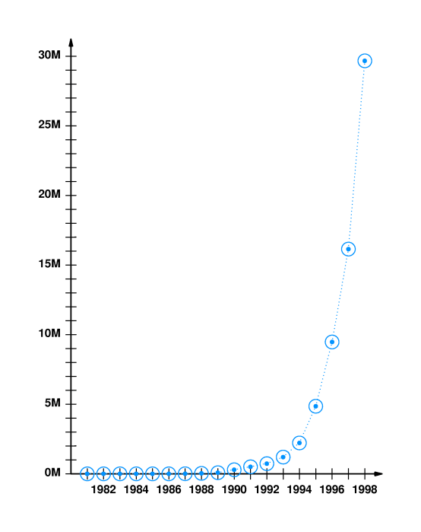
Internet Growth
Number of
connected
computers
Time
Notes:
The reason for concentrating on packet networks is basically the huge growth in the Internet which has happened over the last eight years or so. This graph shows the number of computers connected to the Internet as a function of time. The y-axis shows the number in millions of computers.

Slide 6
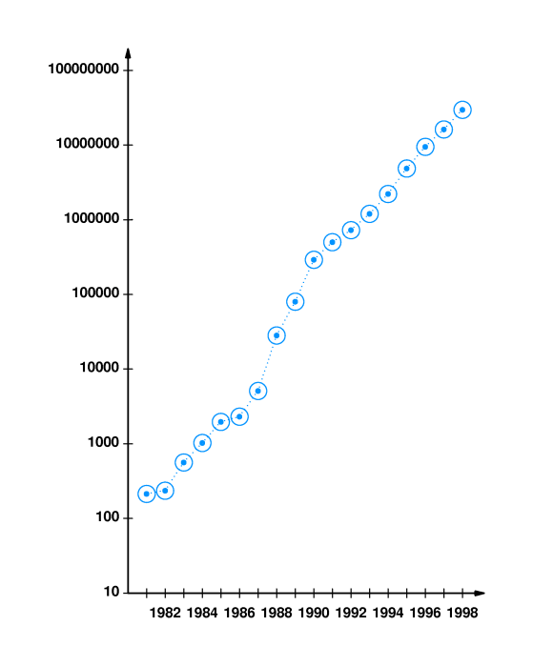
Internet Growth
Number of
connected
computers
Logarithmic plot
Time
Notes:
A logarithmic plot of the data shows the growth to have been exponential over a period of about sixteen years. This gives a growth rate of about 85% per year. If this were to continue unchecked, the whole world would be connected within about 10 years.
Why might we expect this explosive growth to saturate?

Slide 7
Single Link
B
Bandwidth
Error rate/ Signal to noise ratio
Data Rate
Failure probability
A
Notes:
Here we show a classic point to point link which is the domain of transmission systems. The link, which could be twisted pair, coaxial cable, microwave via satellite or optical fibre, has a number of important properties. The bandwidth which can be limited by the properties of the source, the receiver or the link itself. The error rate probability, for a digital line, or the signal to noise ratio, for an analogue line.
Typical bandwidths available are:
56kBit/s, Modem
2MBit/s Cable modem
10MBit/s, Ethernet
100MBit/s, Fast Ethernet
144MBit/s, ATM
2.5GBit/s, optical fibre link
Another important property is the failure probability of the link which might not even be limited by the components involved. For example, in certain undersea systems the mean time between failure is determined by ships (illegally) dragging their anchors during storms.

Slide 8
Network
Switched
Shared Access
Notes:
Here we show two network types.
A switched network consisting of pure point to point links, in this case joined together in a ring. A packet is placed on the network link by a node and propagates to the next node in the network. As a packet arrives at a node it is received and checked to see if it is at its correct destination. If it is then the packet is removed if not it is sent on to the next node and so on until it arrives at the correct node.
A shared access network consisting of a bus to which every node is attached. The packets are placed on the network, subject to an access protocol to avoid simultaneous use of the bus, and all the nodes look at the packet to see if it is for them but only the correct destination node would actually use the data.
These networks both have advantages and disadvantages.
The switched ring network allows many packets to be in transit at any one time. Some optimisation of flow is possible by placing nodes which communicate heavily with each other at adjacent points on the ring. These networks generally have to be bidirectional in order to allow for the possibility of a node crashing or a link failing.
The shared access network allows each node to communicate with any other node at the peak rate allowed by the bus but no guarantee of access to the bus is available. Nodes can be added and removed easily without (necessarily) disturbing the communication between the other nodes on the network.

Slide 9
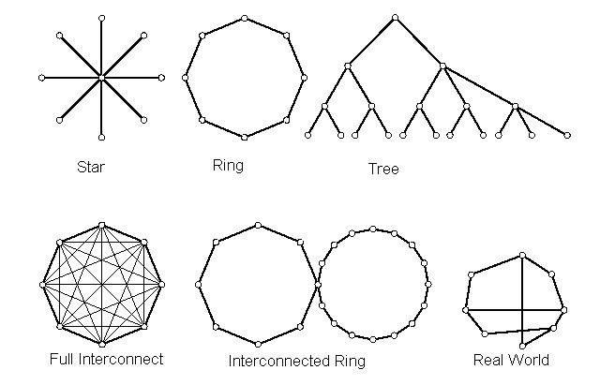
Topology
Notes:
The way in which the nodes of a network are connected to each other is known as the topology. The absolute position of a node is not important only the pattern of its connections to the other nodes.
There are a number of different topologies which are commonly referred to:
The star network consists of a central node to which all the other nodes are connected. This is a common configuration used in twisted pair Ethernets where the central node is a hub.
The ring network, which can be unidirectional or bidirectional.
The hierarchical tree, or nested star, has a multi level structure. This can be useful if the nodes can be ordered so that most communication takes place between adjacent nodes in a given level. As the nodes get further apart (within a level, not physically) then the packets have to rise up through more levels of the hierarchy.
The fully interconnected network isn’t really a network as we have defined it and is rarely used for more than a few nodes for reasons we shall see in the next slide.
The interconnected ring or sets of rings might occur when connecting different networks together, the common node being a router.
Finally there’s the real world which is not like any of the simple cases but contains elements of all of them.

Slide 10
Fully Interconnected Network
Network size of N nodes
So we have: L = N(N-1)/2 point to point links
Scales very badly with N
Incremental network cost is L(N+1)-L(N)
= (N+1)(N)/2- N(N-1)/2
= N
So the cost of adding a new node increases as the network grows, there is no economy of scale.
Notes:
The fully interconnected network would, at first glance, appear to be the ideal solution since no switching is necessary and every node can communicate over a dedicated link to every other node. The problem with this network is one of economics. In the slide you can see how the number of links depends on the number of nodes. For large N it increases quadratically with N.
This means that the incremental cost of adding a new node grows linearly with N so the network becomes increasingly expensive to grow. For telephone networks, where the nodes are users, the maximum number of calls that could possibly take place at any one time is N/2 and so most of the connections would not be in use for most of the time. Not a very efficient use of plant. In modern data networks, multicasting(*) is more prevalent so more simultaneous links are possible but still not enough to make this topology worthwhile.
(*) Multicasting is the sending of a single piece of information from one source to M nodes at the same time.

Slide 11
Network Problems
Routing information
Unique addresses
Rogue packets
Node/ switch/ router failures
Security
Internetworking
Abstraction
Quality of Service
Congestion
Flow Control
Errors
Network measurements
Applications
Notes:
This is a list of the sorts of problems and issues that network designers have to deal with.
Routing: how do we generate and maintain the necessary information?
Unique addresses: how do we ensure there are no duplicates?
Rogue packets: if an error occurs a packet might have a non-existent address.
Failures: What do we do when things go wrong?
Security: How do we keep data secret on a public network, How do I know the sender is who they claim to be?
Internetworking: How do I get data between networks using different protocols?
Abstraction: Do I really need to know everything to use a network?
Quality of Service: How can I stop someone from hogging the network resource?
Congestion: What happens when too many people use the network?
Flow Control: What happens if I can’t handle the incoming data fast enough?
Errors: How do I know the received packet is correct?
Measurements: How do the administrators know if there is a problem?
Applications: How do the applications used affect the provision of network resource?

Slide 12
Internet Resources
Tannenbaum home page
(http://www.cs.vu.nl/~ast)
Material on Comer Book
(http://netbook.cs.purdue.edu)
RFC’s
(http://www.rfc-editor.org/)
example - RFC 1288, finger
Notes:
Here are some links to resources available on the Internet. Tannenbaum’s and Comer’s home pages contain some material such as diagrams which are used in their books. They also contain some additional material which is not in the book.
The link to the RFC’s is a searchable site where the documents which define the Internet are stored. There are also links to other sites with related material.
Refernces for the Books:
Tanenbaum A.S, Computer Networks 3rd ed, Prentice Hall (1996) ISBN 0-13-349945-6
Computer Networks and Internets 2nd ed, D E. Comer, R E. Droms, Prentice Hall (1998), ISBN 0-13-083617-6

Slide 13
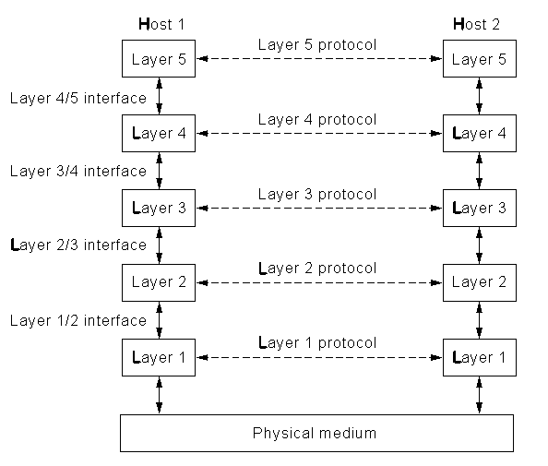
Next Lecture
Protocol stacks
  OSI
  TCP/IP
Notes:
In the next lecture we will look at the issue of abstraction. Why is it necessary? Is it unique? What do the layers do? How do their interfaces work?

Slide 14
Protocol Stacks
Protocol stacks
  OSI
  TCP/IP
Notes:
In this lecture we will look at the issue of abstraction. Why is it necessary? Is it unique? What do the layers do? How do their interfaces work?

Slide 15
OSI Reference Model
Application
Application
Presentation
Presentation
Session
Session
Transport
Transport
Communication Subnet
Network
Network
Network
Network
Data Link
Data Link
Data Link
Data Link
Physical
Physical
Physical
Physical
Router
Router
Host A
Host B
Notes:
This model was produced by the International Standards Organisation (ISO) and its full name is the ISO Open Systems Interconnection (OSI) Reference Model. Its purpose is to define a general model of the processes by which separate and different communication systems can talk to each other. An open system being one that is available for communication with another open system.
The main concept that is used is that of abstraction. The idea being that abstraction enables the whole network problem to be broken up into separate self contained pieces (the layers) that interact with each other in a well defined way (the interfaces). An engineer designing software or hardware for their piece of the abstraction need know nothing about the properties or problems of the other pieces.
The definition of the layers is NOT unique as this is a model of convenience rather than of fundamental classification. Indeed, as we will see, TCP/IP does not fit into this classification. However, this model is widely known and is sufficiently general to cover just about any situation.
Clearly, there are trade offs in producing such a model. If the number of layers is too large we would be unlikely to maintain the independence of each layer. It is also likely that the size of the interfaces would grow to accommodate what would be communication between non-adjacent layers. If there are too few layers then we have not achieved any real degree of abstraction and the original problem of having to know too much remains.
Finally, remember this is a model not a set of protocols. It tells you what sort of thing you should do not how you should do it.

Slide 16
Interfaces
Specifies the relationship between layers
  What services are offered
  What formats are required
Should be fixed
  Layers can be altered without disturbing other layers
  Protection from technology change
Notes:
The interfaces are probably the most important entity to get right in designing a protocol stack. They specify the way layers should communicate and interact with each other. Each layer defines through its interface to the next layer up exactly what it will do and at what ‘cost’. The interface also specifies how the information will be transferred between the layers.
The reason the interface specification is so important is that if it can remain fixed over the lifetime of the protocol stack then changes can be made in any given layer in isolation from any consideration of what is happening in any other layer. If the interface is badly designed or is insufficiently flexible then a change in one layer could also need a change in the interface and hence reconstruction of the next layer or even the whole stack.

Slide 17
Physical Layer
This is where the actual transmission takes place.
The physical layer takes a stream of bits and sends it onto the network. It knows nothing about where the data is going to, what it consists of or how it came to be constructed.
It does know how to recognise bits on the network through the voltage on the line or the optical power received.
Network Card on Host A
Network Card on Router
Network Card on Router
Network Card on Host B
Notes:
The physical layer refers to the actual transmission of individual bits of information. They could be carried as voltages on coaxial cables, pulses of light on optical fibre or microwave signals via satellite. As far as the data link layer is concerned, it sees a virtual physical layer which carries bits of information (rather than physical quantities).
The format of the information is decided here: Return-to-zero (RZ), no-return-to-zero (NRZ), phase shift keying (PSK) frequency shift keying (FSK).
Each piece of the network is a separate entity. In the diagram on the slide, the information bit could be represented in three different formats on the three links.

Slide 18
Data Link Layer
Deals with frames of information
  constructing them
  recognising them from the stream of bits handed up by the physical layer
Handles bit errors that occur in the physical layer
Copes with lost and duplicate frames
Deals with flow control
Special sublayer (MAC) for broadcast networks
Data Link on Host
Data Link on Router
Data Link on Router
Data Link on Host
Notes:
The data link layer takes information from the network layer and breaks it up into frames of bits which enable it to cope with potential problems at the physical layer. Most transmission media suffer from random errors (in fact Shannon tells us we should have errors for high efficiency) and the purpose of this layer is to eliminate them. As far as the network layer is concerned it is handing packets to and getting packets from a perfect error free virtual physical layer.
Bits are added to the data from the network layer to allow errors to be detected and in some cases corrected.
The layer may also use special bit patterns to allow it to detect the start and end of frames. In order to do this the patterns must be unique. If they should occur at some point in the data then something has to be done to hide them.
Each individual data link is still independent. The protocols that are used in each link can be different (simplex, duplex, sliding window.....).
The layer also deals with the issue of flow control (actually this applies to most layers) so that if too many frames arrive for it to cope with the flow is reduced.
On broadcast networks, such as Ethernet, there is a special sublayer called Medium Accsess Control (MAC) which deals with the problems of conflict between to simultaneous access attempts.

Slide 19
Network Layer
Routing
  how will the information get to its destination?
Addressing
  addresses may change in different parts of the network
Billing
  mostly an issue in telephone networks
  bit transport charging could happen
Network on Host
Network on Router
Network on Router
Network on Host
Notes:
The network layer is the highest layer that will exist in a router. It is also the last layer which works on a link by link basis. As far as the transport layer is concerned it is handing information to a perfect virtual point-to-point physical layer albeit on a packet by packet basis.
The network layer is primarily responsible for the routing of the information across the whole network. It can determine if the destination is on its subnet, in which case the packet is simply sent through the appropriate routers, or if the destination is ‘somewhere else’, in which case the packet is sent via the gateway to the outside world. When the destination network is different it must also deal with any problems that might arise from their differences.
It is this layer which defines the network addresses that the transport layer must use.
Exactly how much functionality is built into this layer depends on the type of service which is being offered. This is the prime battle ground of the connection-oriented vs connectionless debate. TCP/IP and ATM take different stances at this point as one is principally connectionless and the other is connection-oriented.

Slide 20
Transport Layer
End to end control
  splitting data into chunks
  ensuring delivery
  recombining chunks
Connections
  manages network connections
  controls throughput
Transport on Host
Transport on Host
Notes:
The transport layer protocols on the source and destination machines communicate (virtually) directly with each other. They do this through the message headers which they attach to data coming from the session layer and through control messages which may be generated in the network.
The transport layer can optimise the traffic from the session layer (note not from a particular source program) across the network. This may involve creating multiple network connections or multiplexing data from separate streams onto a single channel. This must all be done transparently so that each source of a stream sees the transport layer as a perfect virtual permanent connection. In this context the degree of permanency depends on the service being offered to the session layer. In order to maintain transparency to the session layer the transport layer must keep track of how the data is split or multiplexed and must communicate that information to its counterpart.
It is here that the difference between connection oriented and connectionless service will appear to the session layer. In practice the amount of work that needs to be put in to packet reordering and retransmission depends on the network service being used. This is one of the differences between ATM and TCP/IP

Slide 21
Session Layer
Session examples
  remote login, the session is maintained even if no data is being transferred
  synchronisation, progress of operations is tracked so that crashes can be recovered from
  token management
Session on Host
Session on Host
Notes:
A session is a connection with state information that can be maintained between two machines. The state information might describe the progress through some session protocol, information about the form of encryption being used or the possession of tokens used to regulate the progress of a protocol.
The regulation of progress is known as dialogue control. The simplest example being the use of the word ‘over’ during radio communications. ‘Over’ can be thought of as a token which the users exchange to keep track of whose turn it is to speak.
The session layer may not be involved in a particular communication between applications.

Slide 22
Presentation Layer
Manages representations
  ASCII vs Unicode
  Integer types
  Floating point numbers
Presentation on Host
Presentation on Host
Notes:
The presentation layer is responsible for translating between different formats that might be used on different machines. This requires the layer to have knowledge of specific data formats such as characters, integers and floating point numbers. Data is not transmitted as an arbitrary sequence of bits as in most layers but is treated in a specific context. The idea here is that the presentation layer makes the remote machine look as if it is of the same type of architecture and uses the same format for representing data.
One common area is the representation of characters transmitted as Email. The presentation layer needs to be able to translate between the various formats (ASCII, Unicode) that exist for the binary encoding of character information.

Slide 23
Application Layer
Highest level protocols
  E mail
  Directory look up
  Virtual terminals
  File formats
  WWW
Application on Host
Application on Host
Notes:
The highest level protocols exist here. Working in this layer, the programmer is almost completely unaware of the presence of the network. For example, when using the WWW, clicking on a hyperlink the programmer knows to hand that URL to the application layer which will hand back the contents of the URL. At this level, all the users appear to be connect to the same machine with the same file store. The ultimate level of abstraction has now been achieved.

Slide 24
OSI and TCP/IP
Application
Application
Presentation
Session
Transport
Transport
Network
Internet
Data Link
Host to Network
Physical
Notes:
The comparison between the OSI reference model and the TCP/IP protocol illustrates the point about the classification of the protocol stack not being unique. In fact TCP/IP does not uniformly map onto the OSI reference model and this was one of the reasons for OSI not being more widely used. For a good discussion of the interplay between politics and technology see sections 1.4.3 to 1.4.5 of Tanenbaum.

Slide 25
Next Lecture
Switching architectures
Blocking
Buffering
Notes:
In the next lecture we will look at some of the architectures that are used to achieve switching in networks. We will look at the problem of blocking that happens when one network connection makes other connections impossible and the related issue of buffering that arises when there is contention for a resource.

Slide 26
Switching
Switching architectures
Blocking
Buffering
Notes:
In this lecture we will look at some of the architectures that are used to achieve switching in networks. We will look at the problem of blocking that happens when one network connection makes other connections impossible and the related issue of buffering that arises when there is contention for a resource.
For additional material on this topic see
Telecommunications Switching, Traffic and Networks by J.E.Flood
and
Optical Networks, A Practical Perspective by Ramaswami and Sivarajan

Slide 27
Full Crosspoint Switch
Single stage
  crossbar
  connects any input to any output
Contention
N x N switch
N inputs
N outputs
controller
Notes:
The general fully interconnected crosspoint switch is able to connect any combination of inputs to any combination of outputs. An example of such a switch fabric is the crossbar switch named after its early implementation in the form of movable bars which could be pushed to form connections. In order to achieve the correct connectivity in the network, the switch has some form of controller which makes the appropriate connections. In order or the controller to make the right decisions it needs to know something about the state of the input lines and their data and also about the output lines and their data. In a connection orientated network the switch connections are negotiated as part of the call set up. Each call may last a different time and so the switch makes connections as and when calls are set up.
In a packet network the switch operation will depend on the nature of the network. If packets are of fixed size and synchronous then the switch setup can be changed on a packet by packet basis and only information about the input needs to be obtained. If the packets are of variable size then the switch can either fragment them input equal sized pieces or it has to maintain output state knowledge as well.
Contention occurs when two or more inputs have data for a single output. In a connection orientated network the call would be refused as insufficient resource is available. In a connectionless network the switch could simply drop the packet but there are better things that could be done as we will discuss.

Slide 28
Crossbar Switch
Cross points can be connected
packet and circuit switching
inputs and outputs can be different numbers
switch size scales as N²
Notes:
The crossbar switch can be thought of as (logically this is always so but in the early days they were actually made like this) two orthogonal sets of lines which can be connected at the crossover points. The connections are determined by the controller.
The switch has been used both in circuit switching and in packet switching and is suitable for use both in synchronous and asynchronous applications.
Once the crosspoint is connected the data can flow through the switch, in the slide two connections are shown from input to output. It is not necessary for the number of inputs and outputs to be the same and this feature is often used in concentrators and expanders.
The switch size scales with the square of the number of lines (for a symmetric switch) . So for a large network the cost of such switches would eventually dominate the network costs. Fortunately it is possible to design switches with better scaling properties.

Slide 29
2 layer switch
2
3x3
5
only uses 6*9 = 54 crosspoints rather than 9*9 = 81
penalty is loss of connectivity
Notes:
In the slide we show a 2-layer switch. The example is for a nine by nine switch composed of six three by three switches. The smaller switches are arranged in two layers, the first layer is connected to the input and the second to the output
The outputs of the first switch in the top left are all connected to the first input of one of the three output switches. This switch has a total of 54 crosspoints which is smaller than the 81 used by the fully interconnected switch. So, have we gained something for nothing? The switch has full interconnectivity in that every output can be reached from every input. However, there are some combinations of connectivity which cannot be achieved. Suppose input 2 is connected to output 5, it is no longer possible to simultaneously connect either of inputs 1 or 3 to outputs 4 or 6. This is because there is only one line from each of the input switches to each of the output switches. This situation is known as blocking. We can get round the blocking problem by including an extra layer of switches between the input and the output.

Slide 30
3 layer switch
Connect
2-5 as before
1-6
3-4
Blocking still possible
Notes:
The three stage network shown in this slide does not have the blocking problem that the two stage network had. The original connection between 2 and 5 can be made but now we can also connect 1 to 6 and 3 to 4 at the same time. The switch still blocks but we need to put four connections in place before we see this.
However it now uses 81 crosspoints which is the same as the fully interconnected switch that we started with. In general, this type of network will use more crosspoints if we want it to avoid the blocking problem.
The breakthrough in switch design was made by Clos in 1953 when he showed how switches could be designed with fewer than N² connections without blocking the network.

Slide 31
Blocked 3 layer switch
*
*
Notes:
In this slide we show the same nine by nine three layer switch in a blocked state. The first four connections have made it impossible to connect the third input to the seventh output, as marked by the asterisks.
The third input can only reach the bottom middle switch whereas the seventh output line can only be reached from the top output switch.

Slide 32
Blocking
Blocking
  When a connection is made it can exclude the possibility of certain other connections being made
Non-blocking
  A new connection can always be made without disturbing the existing connections
    wide sense: provided the correct connection rule is applied
    strict sense: any connection rule will do
Rearrangeably non-blocking
  A new connection can be made but it might be necessary to reconfigure some other connections on the switch
Notes:
We have already used the terms blocking and non-blocking which have fairly obvious definitions shown here.
The non-blocking switches are further divided into two sets. Wide-sense non-blocking requires a certain rule for setting up connections to be followed in order to avoid getting into a blocked state. Strict-sense non-blocking switches can use any valid path at any time.
There is a further class of switch networks known as rearrangably non-blocking. In such switches it is always possible to connect a given set of inputs to a given (valid of course) set of outputs. However, when a new connection is required it may not ‘fit’ with the existing set of connections and new paths have to be found for the old connections as well as the new one.

Slide 33
Clos Network
nxp
gxg
pxn
g switches
p switches
g switches
Notes:
Clos worked out how to design networks of switches such that the number of crosspoints could be less than that of a simple crossbar switch.
In the example shown here we consider a three layer switch with n by p gates in the input and output layer and g by g gates in the middle layer. If N is the number of input lines then we have N = ng. The layers are connected in the same manner as the previous switches we have considered but only a few connections are shown here.
The blocking example we have just considered occurs when n-1 lines are tied up on an input switch and n-1 lines are tied up on a single output switch and they are all connected to different middle switches. If this happens then the addition of one more switch would enable the final call to get through. Thus we arrive at the result that the minimum number of switches p in the middle layer is (n-1) +(n-1)+1 to give 2n-1. So the number of crosspoints is
for large n this is minimum when
and at this value there are crosspoints.
Note that each of these switches could itself be a Clos network allowing a recursive design process.

Slide 34
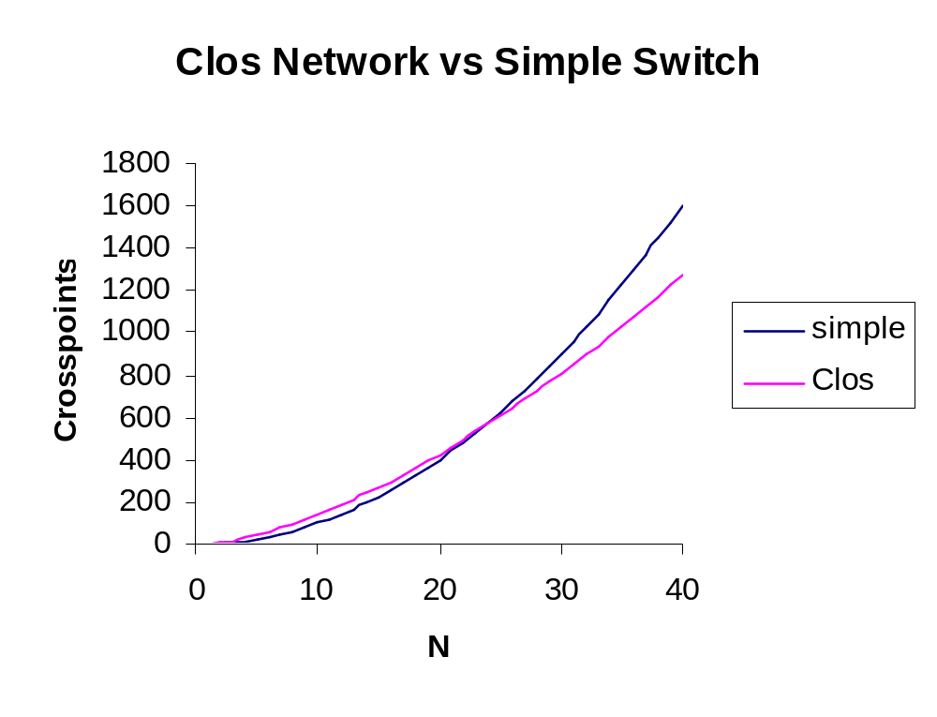
Notes:
This graph shows the comparison between the 3 stage Clos network and a simple switch with N² crosspoints. For large switches the Clos network can produce a saving while guaranteeing non-blocking performance.

Slide 35
Benes Network
Rearrangably non-blocking
e.g.
2 to 1
, 1 to 5
, 3 to 3
, 4 to 2
Notes:
This slide shows a sequence of connections that results in a blocked state. The connections (2,1), (1,5) and (3,3) are made and then a request for (4,2) comes in. As you can see from the blue lines the existing state of the crosspoints forces the connection must fail since there is no way for the two ends to meet.

Slide 36
Benes Network
Now use different connections
e.g.
2 to 1
, 1 to 5
, 3 to 3
, 4 to 2
Notes:
In this slide we will take the same set of connections but now use different paths through the switch in order to allow all of them to be connected. The difficulty in operating this kind of rearrangeably non-blocking switch lies in finding the algorithm for finding the correct combination of settings.
If there are n crosspoints each with two possible settings then there are 2^{n} possible states of the switch.This is very bad when it comes to scaling the problem since the size of the search space grows exponentially with the number of crosspoints. For small switches we could work out once only the settings for each combination of input to output connections of which there are
N! Where N is the number of inputs to the switch.
The real reason for wanting to use switches like this is that the number of crosspoints required is
which is much smaller than N².

Slide 37
Dilated Switches
Optical Switches
  crosstalk can be a problem
  limits number of switches in network
  use dilation
Doubles the isolation in dB
Notes:
Optical switching is likely to be one of the key technologies of the future. One problem encountered in optical switches is that of isolation of the undesired output.
The first diagram shows a two by two optical switch in the bar state. The dotted arrow shows that some of the signal is leaking to the unwanted output port. This signal degrades the signal to noise ratio of the channels and will accumulate as the signal passes through more switches ultimately leading to the complete unreadability of the data.
One technique used to get round this is called dilation. Four switches are used as shown at the bottom to construct a single two by two switch. The unwanted signal now has to cross two switches in order to get to the unwanted output port. Thus the effective isolation of the dilated switch is twice (in dB!) that of a single switch. Of course the switch is now more expensive and has more control lines etc.

Slide 38
Contention
What happens when two inputs want the same output?
  Connection-orientated transmission will refuse the call
  Connectionless transmission can buffer
N x N switch
Queue
Queue
controller
Notes:
Contention occurs when two inputs both want to access the same output. In a connection-orientated network the call will usually fail as there are insufficient resources available. In a packet based network we have three main options:
Drop the packet
Re-route the packet
Store the packet
The first option is not very user friendly but ultimately whatever else we might try this may have to happen.
Re-routeing is an option, we could send the packet down a second best path if that were known or we could simply send the packet down any available line and hope that it will eventually reach its destination. The latter method is actually a routing scheme known as ‘hot potato’ or ‘mad postman’ routing.
In the slide we show an N by N switch which has had input and output buffers added to it. The switch controller now has the added responsibility of detecting contention and managing the buffers. There are a number of techniques that can be used. Each input line has a buffer into which packets are placed when they arrive and from which they are taken when the appropriate output is free. In some cases the switch might have the capability to take two packets from one buffer to use a spare output line rather than leaving it empty. The scheduling algorithm responsible for this can be quite complex. However, it must come up with some result when the switch is next ready to be set. This results in quite simple algorithms being used in high speed routers.

Slide 39
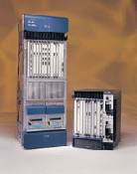
Cisco Gigabit Router
High throughput routers
  web site
  abandoned shared backplane
  now use crossbar switch at core
  caters for up to 2.4GBit/s links
  optical I/O
Notes:
This slide shows one of the latest offerings from Cisco in its high end router range. The Cisco 12000 router is designed as a fast internet router serving links which will eventually go up to 2.4GBit/s. The I/O will allow for optical interfaces.
Whereas most Cisco routers use a shared backplane, some form of fast Ethernet, the 12000 series uses a crossbar switch.
The web site pointed to here is:
http://www.cisco.com/warp/public/cc/cisco/mkt/core/12000/index.shtml
and a technical document describing fast routers can be found here:
http://www.cisco.com/warp/public/cc/cisco/mkt/core/12000/tech/fasts_wp.pdf

Slide 40
Next Lecture
Relationship of Data Link Layer to Network Layer
Error control
  Democratic voting strategies
  error detection and correction
  Parity
  Hamming distance and Hamming codes
  CRC codes
Framing
Notes:
In the next lecture we will discuss some of the ways for dealing with real transmission where errors are introduced.
First we look at a simple voting strategy for transmitting information on a noisey line. No explicit error control is used in this case.
We can distinguish between error detection, where for example an error can be detected but the nature of the error is unknown, and error correction where an error can both be detected and corrected. It is not possible to correct for all possible errors so error correction can only work for a range of possible errors. Different codes will be able to detect for different types of error and the selection of the most suitable code will depend on the details of the transmission line. In some cases, bursts of errors are much more likely than isolated errors but these can be accommodated.
We will also discuss the issue of framing which arises from the need of the data link layer to be able to tell when a sequence of bits starts and stops.

Slide 41
Data Link Layer(1)
Relationship to Network Layer
Error control
  Democratic voting strategies
  error detection and correction
  Parity
  Hamming distance
  CRC codes
Framing
Notes:
In this lecture we will discuss some of the ways for dealing with real transmission where errors are introduced.
First we look at a simple voting strategy for transmitting information on a noisey line. No explicit error control is used in this case.
We can distinguish between error detection, where for example an error can be detected but the nature of the error is unknown, and error correction where an error can both be detected and corrected. It is not possible to correct for all possible errors so error correction can only work for a range of possible errors. Different codes will be able to detect for different types of error and the selection of the most suitable code will depend on the details of the transmission line. In some cases, bursts of errors are much more likely than isolated errors but these can be accommodated.
We will also discuss the issue of framing which arises from the need of the data link layer to be able to tell when a sequence of bits starts and stops.

Slide 42
Relationship to Network Layer
Get data from NL on source to NL on destination
Provide Services e.g.
  Unacknowledged connectionless service
  Acknowledged connectionless service
  Acknowledged connection-oriented service
Notes:
The main goal of the data link layer is to transfer data between the two network layers at the ends of the link. These network layers will not in general be part of the ultimate source and destination machines for the message.
The data link layer provides a set of services to the network layer and it is up to the network layer to specify which service it needs. The following are typical (but not compulsory) services
1. Unacknowledged connectionless service
This is the most basic form of transmission. Frames are sent out to the destination without establishing a connection (and hence a path) and without waiting for any acknowledgements. If data is lost it would be up to higher layers to recover (if recovery is needed). This service is suitable for very reliable physical layers where frame loss or corruption is rare. It has a very low overhead thus making efficient use of the available bandwidth. It is also suitable for transmission where data loss is not critical (e.g. real time services).
2. Acknowledged connectionless service
As in 1. but frames must be acknowledged. The data link layer takes the responsibility for retransmitting lost frames. This service would be more appropriate in the case where the physical layer is not perfectly reliable. It would be possible for problems to be recovered at higher layers but that would require re-sending entire messages rather than individual frames.
3. Acknowledged connection-oriented service
As in 2 but with a pre-negotiated connection between source and destination. The order of frames is guaranteed by this service, this involves numbering the frames. This service requires the most use of resources in the layer.

Slide 43
Voting
No error control
Re transmit the information N times
Receiver accumulates the results and treats them as votes on individual bits.
Error probability per bit is p
Mean number of received bits = N(1-p)
Threshold at N/2
Notes:
If we have no explicit error control, we could consider using a democratic voting strategy. The information frame is sent N times to the receiver. When each frame arrives it forms the decimal sum of the total number of bits received in each slot.
The width of the distribution of the number of bits received will scale as 1/N so provided the peak of the distribution at N(1-p) is more than 1/ N above the threshold value of N/2 the probability of an error is greatly reduced.
Of course this strategy is enormously wasteful in bandwidth.

Slide 44
Error Control
Real transmission is never error free
Error detection
  knowing there is an error but not where
Error correction
  knowing there is an error and being able to work out where it is
Here ‘an error’ really means ‘an error syndrome’ which refers to a collection of specific errors in general.
Notes:
Errors in transmission lines can come from various noise sources. Truely random events such as thermal receiver noise or quantum fluctuations in the Poisson statistics of photons will generally give rise to Poisson distributed single bit errors.
Other noise sources can include external influences such as crosstalk from another system. In some cases these will give rise to a burst of errors. A burst is defined as a sequence of bits for which the first and last bits are in error and the intervening bits might be.
We will often refer to an error when we should really say an ‘error syndrome’. An error syndrome is a more general term indicating that any number of bits may be in error.
The general idea of these codes is to transmit more bits in the message than there are in the original data. The extra bits carry redundant or distributed information about the message bits. Clearly this reduces the effective data rate of the transmission relative to the raw line rate. It does of course increase the effective information transmission rate.
In general error correcting codes require more overhead than error detecting codes since more information is required to work out exactly what went wrong.

Slide 45
Error Control Codes
Detection is the ability to detect but not correct
  parity is the classic example
    p = b_{n}  b_{n-1} ............b₁  b₀
     = exclusive or
    only useful when bit error rate is very small
Hamming Distance
  H(a,b) = decimal sum (a_{n} b_{n})
  H(10100, 11010) = (0+1+1+1+0) = 3
  if H(a,b) = d then d single bit errors are needed to change a into b
Notes:
The inclusion of a parity bit is the classic example of a simple code which can detect single bit errors but not correct them. In the context of packet transmission a re-transmit request would be issued to the source node following the detection of an error. A single parity bit is unable to detect two bit errors which are the next most likely random error to occur. The parity is simple to generate as the cumulative Exclusive Or of the message bits and is commonly generated in hardware.
To deal with a simple error correcting code we introduce the concept of the Hamming distance between two words. It is simply the number of individual bits in the two words which are different. To put it another way, it is the number of bits in either word which need to be changed to make them the same.
Note that a simple coding scheme like 1->1111111111, 0->0000000000 is an example of a voting scheme.
We now introduce a geometrical picture of codes.

Slide 46
Codes as Vectors
111
011
001
101
010
110
000
100
Notes:
The slide shows a simple example of the possible words that can be formed using three bits. They are represented on three dimensional axes as the points on the vertex of a cube as shown in the slide.
The edges of the cube represent transitions from one word to another by changing a single bit. For example the solid axes represent the transitions:
(000) to (001)
(000) to (010)
(000) to (100)
Suppose we now represent a single message 0 by the code (000) and a single message 1 by the code (111)
A single bit error on (000) will change the word to one of the set {(010),(100),(001)} and a single bit error on (111) will produce one of the set {(011),(101),(110)}. Since these two sets are distinct we can immediately tell if we receive (101) that (111) must have been transmitted and so produce the correct code. Note that any of the pairs on the diagonals of the cubes could be used to represent the single message bits. Indeed in some cases it may be preferable to use a pair like {(101),(010)} in order to avoid extended sequences of ones or zeros.
If we tried to squeeze more message bits into this space we would find some words which are reached by single bit errors from more than one code word making the error correction impossible.

Slide 47
Dimensions
Use d code slots (work in d-dimensional space)
Total number of code words = 2^{d}
Each point has d neighbours reachable with a single bit error
To be able to correct all single bit errors make all d+1 clusters distinct
So (d+1)2^{k}  2^{d}
where k is the number of bits to be encoded.
E.g. d=3 gives k=1
Notes:
With more message and code bits it would be necessary to plot the points in a higher dimensional space which we can’t do but the general geometric picture is still valid in this case.
Suppose we use a total of d code slots so that there are 2^{d} possible code words. If we want to correct for single bit errors then each transmitted code word has to be surrounded by code words that are equivalent to it (i.e. when a single bit error occurs) but are not transmitted. Since a point on a d-dimensional cube has d nearest neighbours each message word is associated with d+1 code words. If we have k message bits then there will be 2^{k} message words each associated with d+1 code words. In order for the code to work the desired number of code words
2^{k} (d+1)
has to fit in the space which has size
2^{d}
giving the criterion quoted on the slide.

Slide 48
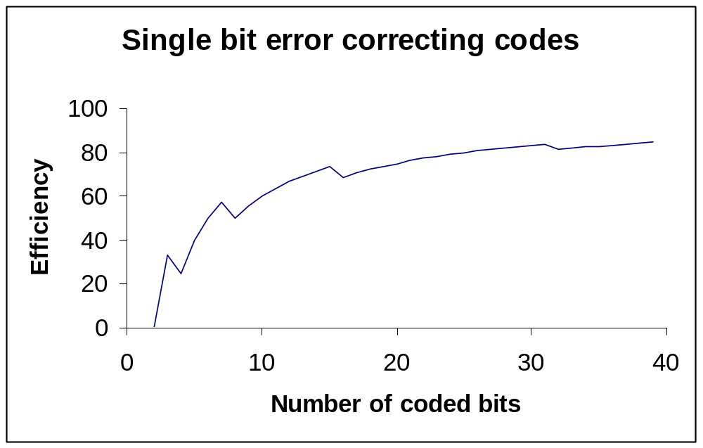
Efficiency
Define efficiency as ratio of coded bits to code bits= k/d
Notes:
The efficiency of a code can simply be defined as the ratio of the wanted message bits to the total code word bits.
This graph shows the efficiency for codes satisfying the bound derived in the previous slide. This curve approaches the asymptotic value of 100% very slowly so that in order to preserve efficiency very large message blocks must be coded.
The Hamming codes discussed in section 3.2.1 of Tanenbaum are examples of codes satisfying the bound.

Slide 49
CRC codes
One of the commonest sets of codes used are the:
Cyclic Redundancy Codes or polynomial codes
  based on Galois field theory
  use arithmetic modulo 2
  represent data as polynomials
  can be constructed to correct for a wide combination of errors
Notes:
Their properties can be derived from Galois field theory, a branch of mathematics describing modular arithmetic. First we will review arithmetic modulo 2 and look at some of the simple polynomial operations that are used. Then we will look at how the code words are formed from the generator polynomials and what the simple properties of the codes are.
This formalism is also used to discuss the properties of pseudorandom number generators that are used in bit error rate test equipment.
Some of the widely used codes have been defined as international standards.

Slide 50
Modulo 2
Strictly speaking this is an algebraic field and although we write things that look like numbers they do not have a carry associated with them.
With carry:
101
001
110
Without carry:
101
001
100
Notes:
In this slide we review the basic operation of addition modulo 2 performed at the level of a single bit. This operation is perhaps better expressed as the bitwise exclusive or of the two bit strings since addition implies the existence of carry bits both for addition and subtraction. The message bit strings we wish to encode are really lists of bits and not numbers (even if, coincidentally, they represent a number). The slide illustrates the two results that would be obtained with and without carry.
The ‘with carry’ calculation is appropriate if the bit strings represent numbers and the one shown in the slide corresponds to 5+1=6.
The ‘without carry’ result is simply the result obtained by applying the rules I have given you. It should not be interpreted as having any numerical significance.

Slide 51
Polynomial representation
This is clearer if we use a polynomial representation:
the bit string 1101 is represented by the polynomial
x³+x²+1, the coefficients of the polynomials can only be 0 or 1
Now the sum 101 + 001 becomes
x²+1+1 = x², since 1+1 = 0
We can also multiply and divide in this representation
(1+x²)(1+x²) = 1+x²+x²+x⁴ = 1+(1+1)x²+x⁴=1+x⁴
Notes:
The bit strings can be represented as polynomials and shows why there is no carry operation. The bit string is read from left to right with the first bit being the coefficient of x^{k-1} where k is the number of bits in the string. The next bit is the coefficient of x^{k-2} and so on until the rightmost bit which is the coefficient of x⁰.
The lack of a carry come from recognising, for example, that x+x is not x² but x(1+1) = 0.

Slide 52
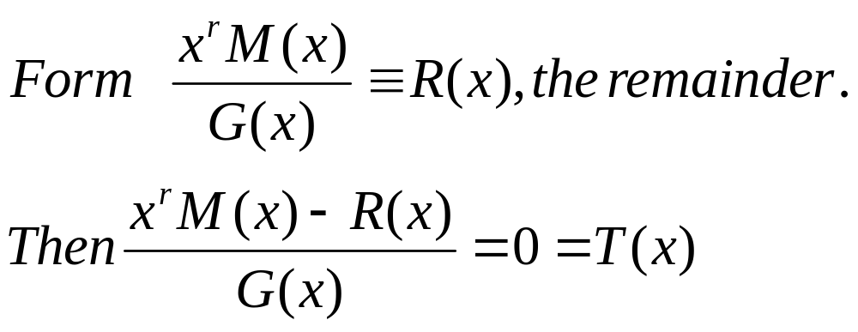
CRC coding
Let M(x) be the message polynomial and define G(x) to be a generator polynomial of degree r
T(x) is now the code to be transmitted. If errors occur, what is received is not T(x) but T(x)+E(x) where E has a coefficient of 1 for each position where an error has occurred. We can now divide the received polynomial T(x)+E(x) by G(x) and obtain E(x)/G(x) which characterises the error syndrome.
Notes:
Division proceeds by using the techniques we first used in primary school. An example of such a calculation can be found in figure 3-7 of Tanenbaum.
The remainder is calculated in the way shown in the slide. For comparison, suppose we take the numerator to be the number 51 and the denominator to be the number 7. The remainder would be 2 since 51=7*7+2. This can be rearranged by subtracting the remainder (2) from both sides to get
(51-2)/7 = 7 rem. 0 or in modulo 7 arithmetic 49/7 = 0.
Thus given any message polynomial the procedure produces a code polynomial which is exactly divisible by the generator polynomial.
When an error polynomial is added by the transmission line the received code is divided by the generator to reveal the error syndrome (apart from factors of the generator polynomial).

Slide 53
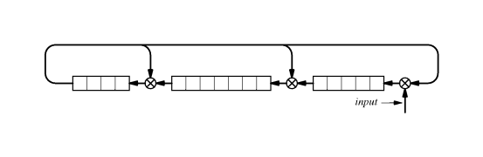
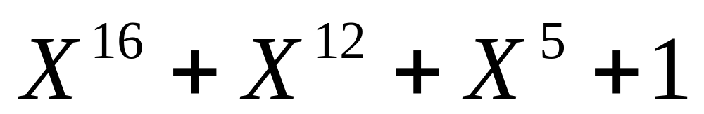
CRC Hardware
Notes:
The CRC codes can be implemented very easily in hardware. They use shift registers with taps at the appropriate points where the bit fed back and the previous shift register position are combined in an exclusive OR gate. The shift register shown here implements a standardised code known as CRC-CCITT.
The message is applied to the input and the result after it has passed through the register is the CRC code to be appended to the message.
The file lecture4.xls (available on the web) is an excel spreadsheet implementation of the CRC code shown in the slide. There are two sheets, one for the transmitter and one for the receiver.

Slide 54
Framing
Data Link layer
  responsible for extracting packets from a bit stream
  uses special characters to identify start and end of frame
  needs to hide their natural occurrence
  use of stuffing
e.g. Start = esc S, End = esc E
  also need to hide any natural esc by translating to esc esc
Notes:
One function of the Data Link layer is to determine the presence of packets within bit streams. This is done by making certain bit combinations special. However, it is possible that these combinations will occur as part of the data and the purpose of framing is to code them in such a way that they do not interrupt the frame detection process.

Slide 55
Framing example
The message
A esc S esc esc D
becomes
esc S A esc esc S esc esc esc esc
D esc E
where the extra characters have been highlighted.
When the inverse translation is applied the original message is recovered.
SLIP is an implementation of this sort of framing.
Notes:
The slide shows a short message undergoing framing. The start and end sequences have been added as usual. The message actually contains an esc S sequence which would cause a problem if left alone. The translation of esc to esc esc gets round this. When the message come sot be reconstructed the first double occurrence is treated as a single escape and the S that follows is allowed to pass without being treated as a special character. The example also shows that multiple occurrences of the esc character can also be handled.
The Internet data link protocol SLIP (Serial Line IP) is an example of this sort of framing. It is typically used over a modem to connect to an Internet provider. The protocol does not provide any other functionality so negotiation, dynamic IP allocation and error control are not allowed for.

Slide 56
Next Lecture
Data Link layer protocols
  Simple perfect channel
  Stop and wait
  Errors and lost frames
  Sliding windows
  Analysis
The Internet protocol PPP
Notes:
In the next lecture we will consider some simple data link layer protocols and show how different channel properties introduce different requirements into the protocol. One way links, bi-directional communication and the problems of noise and lost frames will be discussed.
We will briefly mention the analysis of protocols through methods such as finite state machine models.
We will also study the main Internet protocol used over modems, PPP.

Slide 57
Data Link Layer(2)
Data Link layer protocols
  Simple perfect channel
  Stop and wait
  Errors and lost frames
  Sliding windows
  Analysis
The Internet protocol PPP
Notes:
In this lecture we will consider some simple data link layer protocols and show how different channel properties introduce different requirements into the protocol. One way links, bi-directional communication and the problems of noise and lost frames will be discussed.
We will briefly mention the analysis of protocols through methods such as finite state machine models.
We will also study the main Internet protocol used over modems, PPP.

Slide 58
Data Link Layer
Deals with frames of information
  constructing them
  recognising them from the stream of bits handed up by the physical layer
Handles bit errors that occur in the physical layer
Copes with lost and duplicate frames
Deals with flow control
Special sublayer (MAC) for broadcast networks
Data Link on Host
Data Link on Router
Data Link on Router
Data Link on Host
Notes:
First we review the functions of the data link layer.
In the previous lecture we dealt with the issues of error control and framing.
The other principle function of the data link layer is to run a protocol to enable it to communicate with other data link layers. The complexity of the protocol will depend on the nature of the physical layer. We will look at a range of protocol examples building up the complexity as we allow the properties of the physical layer to degrade.
Each individual data link is still independent. The protocols that are used in each link can be different (simplex, duplex, sliding window.....).
The layer also deals with the issue of flow control (actually this applies to most layers) so that if too many frames arrive for it to cope with the flow is reduced.
The MAC sublayer which deals with broadcast networks will be dealt with in later lectures.

Slide 59
Protocol Issues
Practical details when designing protocols
  Simplex vs Duplex transmission
  Can I always respond to the network layer
  Can the physical layer always respond to me
  Is the checksum done in hardware or software
  What do I do if an error occurs
  What if packets arrive out of sequence
  How much buffer space do I need
Notes:
As we will see the details of the data link protocol depend on the assumptions made about the transmission in the physical layer. The most basic is whether the data can travel in both directions. The simplest protocol we start with will use a uni-directional perfect link.
In practice the protocol is a program running on some form of computer and it takes a non-zero amount of time to process the instructions. This may result in the machine not having enough time to run all the different layer protocols while the data is continuing to stream in. Thus flow control is essentially necessary at all levels. The network layer may be supplying data faster than the data link layer can process it. Alternatively, data may be arriving too quickly from the physical layer.
In many cases the CRC checksum will be handled at the hardware level and this can be ignored. However, the hardware may still signal an error event to the software and that has to be allowed for. The advantage of a hardware CRC implementation is speed. However the hardware at the other end must use the same scheme or have software configurable to match it. The configuration would require some set up sequence between the two layers. A software implementation has the advantage of being negotiable between the two layers.
The network may be connectionless so packets may not arrive in order. However, the data link layer can still offer a connection-oriented service to the network layer if it tracks packet sequences and reorders them.

Slide 60
Simplex Protocol
Frame arrived
no
Perfect Physical Layer
  error free
  unidirectional
yes
Get data
from NL
Get frame
from PL
Insert into
frame
Extract
data
Pass to
PL
Pass to
NL
Transmitter
Receiver
Notes:
Here is just about the simplest protocol there is. The physical layer is assumed to be a perfect unidirectional link. The data link layer runs on an infinitely fast machine (in practice this means the link rate is much much slower than the protocol processing time). The protocol can fetch data from the network layer when it needs it.
The transmitter executes a simple loop, fetching the next packet from the network layer, inserting it into the correct frame structure and then passing the frame to the physical layer. It is at this point that the checksum would be added by the hardware and the data sent out on the line.
The receiver has almost the inverse sequence but it will need to wait for a frame to arrive in general. Once a frame has arrived it is fetched from the physical layer. The packet is extracted from the frame, including any unstuffing, and then passed to the network layer.
Note that this protocol is only applicable to a single point to point link and thus completely unusable in any networking application.
Also, note the rather fuzzy distinction between physical and data link layer that Tanenbaum uses. Frame recognition is a data link layer task but it is implicitly assumed to be performed by the physical layer in these protocols. Of course we could re-label things and call the bits of hardware doing error checking and framing, ‘hardware data link layer’ and the protocol, ‘software datalink layer’.

Slide 61
Computer Response Times
Need to include flow control
  reducing to the worst case is
    unknowable in general
    wasteful in bandwidth
  Introduce acknowledgements (ack)
    only send a new packet when ack received
Note we are still assuming perfect transmission
Notes:
When the computer response time to a network event such as a frame being received is too slow we must slow down the link. One solution would be for the transmitter to use the slowest rate that any computer it might be connected to can cope with. Of course this is a quantity which is (practically) not knowable and even if it was it would be very wasteful of bandwidth.
The simplest way is to use what is known as a ‘stop and wait’ protocol. The transmitter sends a packet and will do nothing until it has received the acknowledgement (usually referred to as ack) that the packet has arrived safely.
We are still assuming a perfect channel so we do not have to worry about damaged frames or missing acknowledgements.

Slide 62
Stop and Wait
Frame arrived
no
Get data
from NL
yes
Insert into
frame
Get frame
from PL
‘over’
Extract
data
Pass to
PL
Pass to
NL
ack?
no
Pass ack
to PL
yes
Transmitter
Receiver
Notes:
Here are the flow charts for the simple stop and wait protocol. They are a minor variation on the simplex protocol we have just seen. Instead of the transmitter continuously looping around as fast as it can go we insert a loop after the frame has been passed to the physical layer to check on the reception of an ack frame. Once it has been received it can go on to process the next packet. If the transmitting computer was very slow it might be better to place the check loop elsewhere, for example after the next packet has been processed into a frame.
The details of how these loops would actually depend on the architecture of the computer. There would be a difference depending on whether the physical layer had to be polled to test for the arrival of the ack frame or whether the process would be interrupt driven.
The receiver is also very similar to the simplex protocol. All that has been added is the sending of the ack frame after the packet has been passed to the network layer.

Slide 63
Noisy Channels
Noise
  introduces errors into the channel
  can be random or correlated (burst)
Damaged data frames
  error correction can cope with some
  lost frames need re-transmitting
Damaged ack frames
  Need to cope with these too
Notes:
Noise introduces errors in to the channel.These can be randomly distributed causing individual bits to invert or they can be bursty in nature (usually due to interference) where bits in a certain region are very likely to be in error.
In any case the net result is that the frames on the channel are damaged. In some cases this damage can be corrected by the error correcting procedures discussed in the previous lecture. There is the possibility that the errors will be such that a valid frame is turned into a different but still valid frame but can be designed to be very unlikely. If it should happen the transmission will fail but this possibility ALWAYS exists because of the need to send more than one valid message on the network.
One possible solution is to introduce a timeout while waiting for an ack frame. If nothing is received before the timeout occurs a duplicate frame is sent. However, it may be that the ack frame was lost in which case a duplicate frame will now be received. The only way to proceed is to keep track of the frames by giving them an identity known as a sequence number.

Slide 64
Automatic Repeat reQuest (ARQ)
Also known as Positive Acknowledgement with Retransmission(PAR)
Sequence numbers
  going into a finite field in the header so must be cyclic
  how many numbers are needed?
Stop and wait protocol
  Only confusion between adjacent packets since sender waits for a positive ack
  1 bit (2 sequence numbers) will suffice
Notes:
This form of protocol uses a positive acknowledgement to control the advance to the next frame. It also uses sequence numbers to label the frames and to label the acknowledgement frames.
The sequence number field in the header is clearly finite so at some point the sequence numbers will have to cycle back to zero. This is not a problem and can be handled in the software. There must, however be a large enough range of numbers to allow the protocol to work. The size of that range will depend on the details of the protocol.
In this case both the receiver and sender keep a track of the expected sequence number of the next (data or acknowledgement) frame and the protocol will not move forward until that step is complete. The only possible source of confusion is between adjacent packets. The receiver needs to be able to tell if a packet received is the next in the sequence or a duplicate to allow for non-arrival of the ack frames. Don’t even think about acknowledging ack frames or you will end up in an infinite loop. In order to distinguish between adjacent packets in the sequence we only need two numbers so a one bit field in the header will be sufficient.

Slide 65
ARQ sender
Insert into
frame+seq#
Get data
from NL
Increment
seq#
yes
no
seq# OK?
Pass frame
to PL
Start
Timer
Event?
no
no
yes
Get frame
from PL
yes
ack?
Notes:
Here we show the flow chart for the ARQ transmitter.
Starting from the null loop which exits when an event occurs. The sender checks to see if an ack frame has arrived. If not then it may have been a damaged frame or a timeout, in either case we re-transmit the current frame and wait again.
Once a valid ack frame is received and recovered from the physical layer we check the sequence number. If it’s invalid we go back to re-transmit the current frame.
Once an ack frame with the correct sequence number is received we can continue with the next packet and request it from the network layer as before.

Slide 66
ARQ Receiver
Event?
no
Set ack #
Pass ack
to PL
yes
no
Frame?
yes
Set ack #
Get frame
from PL
no
seq# OK?
Pass to
NL
Increment
seq#
yes
Notes:
Here we show the flow chart for the ARQ receiver.
The event and frame loops will exit when a valid frame has been received. The frame is recovered from the physical layer and we then check to see if the sequence number is the one we are expecting. If not, an ack is sent for the previous frame as the ack for that frame may have been lost. We then await the next frame.
If the arriving frame sequence number is correct then the frame is passed to the network layer and the next expected sequence number is incremented. The ack frame is set to the correct sequence number and then passed to the physical layer for transmission.
So if the receiver is expecting frame 1 to arrive but something else does it keeps sending acks for frame 0 until the correct frame arrives. It does this in case the acks for frame 0 are not getting through.

Slide 67
Bandwidth Utilisation
Protocols discussed so far only have 1 frame in transit
  with bandwidth B, delay T and N bits /frame
  transmission time T+N/B
  round trip time 2T+N/B (ack <<N bits)
  effective bandwidth is N/(2T+N/B)=B/(1+2TB/N)
  good utilisation if N >> 2BT
  or N >> possible number of bits on the line
Need more frames in transit
Notes:
The simple protocols we have discussed show how the complexity of the protocol increases as you make fewer and fewer assumptions about the computer and the transmission line. The major problem with this type of protocol is the poor bandwidth utilisation. Even under optimum conditions this protocol will only manage to exchange one frame per round trip time between the two computers.
The criterion derived in the slide is that the number of bits in the frame must be much larger than the total possible number of bits that could be in transit in both directions on the transmission line.
For a typical ethernet running at 10MHz over 200m this works out to N>>130.
However for an optical link running at 10GHz over 50km this works out to
N >> 5MBits.
Even if we could go to such huge frames there are good reasons for not doing so. The probability of errors increases with the size of the frame. The management of such extremely large amounts of data at either end is difficult.
The way to get more useful bits on the transmission line is to have more frames in transit at once. That way the error problem remains controlled and the data units remain a manageable size.

Slide 68
Sliding Window Protocols
S
R
S
R
Round trip time 2T
0123
0
Window
Frames
acks
1
Notes:
The diagram illustrates the basic advantage of the sliding window protocol. Time is shown increasing vertically down, frames travel from the sender(S) to the receiver(R) and acks travel from the receiver to the sender. There are more packets in transit during the communication and so the bandwidth utilisation is much higher.
The simple stop and wait protocol spends much of its time waiting for something to happen as the line is mostly empty. This corresponds to a window size of one frame as shown on the left of the slide.
In the sliding window protocol the line is more fully occupied. The bandwidth utilisation clearly increases as the window size is increased and is maximum when the window size is equal to the round trip transmission time.

Slide 69
Frame Sequencing
Sliding window
  Errors can lead to loss of frames within the window
  Clear need for sequence numbers
Missing Frames
  ‘Go Back n’ protocols restart the transmission at the first lost frame
  Selective repeat only resends the lost frames
Notes:
Clearly, errors on the transmission line can now have more complicated effects. The main one is to cause a packet to disappear. Since the data link layer must return data in the correct order it cannot pass the valid frames on to the network layer until the missing frame has been successfully re-transmitted. There can be no doubt about the need for sequence numbers but the range is still determined by the details of the protocol.
A ‘go back n’ protocol only acknowledges frames received in the correct sequence. So if a frame is missing it stops sending acks and waits and discards subsequent packets. When the sender times out it goes back to the sequence number that has not been acknowledged and starts re-transmitting from there. Note: the sender needs to buffer all frames in transit so that it can go back when it needs to, this protocol corresponds to the receiver having a window size of one (it does not have to be the same as the sender).
A ‘selective repeat’ protocol buffers packets which come in after a missing packet up to the size of the receiver window. When the sender times out and re-transmits the missing packet the receiver then sends an ack for the highest packet in the buffer for which there is a full sequence. The sender hears this ack and knows that all packets up to that sequence have now been implicitly ack’ed. Note that this protocol requires buffer space in the receiver as well as the sender.

Slide 70
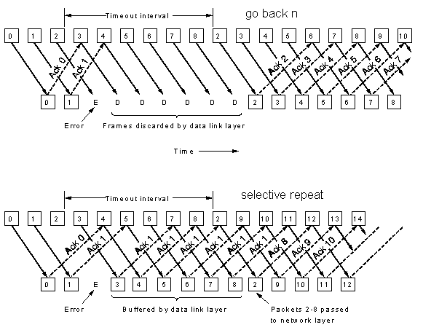
Lost Frames
Notes:
This diagram (Tanenbaum 3-15) illustrates the two protocols ‘go back n’ and ‘selective repeat’ in operation recovering from a lost packet.
Note that according to this diagram the line is permanently full so the sender window size is larger than the round trip time. Also note that for the selective repeat protocol, the timeout for frames 3 and 4 should have occurred before the acknowledgement for frame 8 is received. In practice the window size is usually much smaller than the round trip time and this problem would not happen. Remember to be careful when looking at diagrams in books which are intended to illustrate a point, they may not get all the details right.

Slide 71
PPP
Point to Point protocol (RFC1661)
  Framing
  Link Control Protocol
    Manages the link, testing, option negotiation
  Network Control Protocol
    negotiates Network Layer options
Flag
Address
Control
Protocol
Payload
Checksum
Flag
Notes:
The Internet protocol PPP is fully described in RFC 1661 which is a 50 page document. It is designed to enable networking principally over modems. This protocol is used by almost everyone connecting to the internet over a modem. It is used by the Windows Dial Up Networking program.
The protocol uses the frame structure shown here. The size and existence of some of the fields can be altered by the LCP part of the protocol.
The link control protocol is used to set up the initial connection and to negotiate the options to be used during the connection.
The NCP is specific to each Network layer protocol. For IP, it would establish whether an IP address is already known or if dynamic IP addressing is required.

Slide 72
Next Lecture
Local Area Networks
  Broadcast networks
    Channel allocation
    Ethernet
    Token Ring
    Token Bus
Notes:
In the next lecture we look at broadcast networks. These networks have a unique set of problems to do with shared transmission media. These problems are dealt with by the Medium Access (MAC) sublayer of the data link layer.
We will review the problems of channel allocation, contention resolution and performance.
We will also look at some examples of broadcast networks.

Slide 73
MAC sublayer
Local Area Networks
  Broadcast networks
    Channel allocation
    Ethernet
    Token Networks
Notes:
In this lecture we look at broadcast networks. These networks have a unique set of problems to do with shared transmission media. These problems are dealt with by the Medium Access (MAC) sublayer of the data link layer.
We will review the problems of channel allocation, contention resolution and performance.
We will also look at some examples of broadcast networks such as Ethernet (based on IEEE 802.3) and Token networks.

Slide 74
Channel Allocation
Broadcast Network
  Shared Medium and Bandwidth
  How to allocate it amongst the users
    Static
    Dynamic
  Collision management
Notes:
The major problem to be addressed in any shared access medium is that of channel allocation. We have to decide how the resource is going to be divided up amongst the users. Do we care about fairness? Perhaps we want to be able to sell the resource so that people who want more of it need to pay more.As in all cases of sharing there are trade-offs to be made. The trade-offs can be between the delay in being able to access the network and the bandwidth made available. They can also be between overall performance and protocol or hardware complexity.
The two methods for allocating the resource are static and dynamic.
Static allocation is equivalent to physical addressing where the individual address of a station is given by some physical quantity such as a time slot of a wavelength. The management is very simple and consists of letting the stations know what their physical addresses are. Once this is done the stations communicate independently of each other. The down side is that the amount of bandwidth available to a station does not depend on the overall load, so that when the network is quiet, the station still only has its small portion of the resource and the rest is unused.
Dynamic allocation generally allows each user access to the full resource as if they were the only station but access is not guaranteed and contention with other stations can occur. Under low load conditions, single stations can use the medium very efficiently. However, the contention and inevitable frame collisions mean the maximum possible throughput is less than the total available bandwidth.

Slide 75
Static Channels
User 1
User 2
User 3
..............
User N
How many users?
Simple to manage
Wasteful if slots unused
Little gain over independent provision of physical access
Notes:
The slide shows a static channel allocation of some resource amongst N users. This could be a set of time slots or a set of frequency slots. One issue in designing the network is how many users will there be. Ideally you should have exactly the right number. If there are too few, then the unallocated slots waste bandwidth. Once the maximum number has been achieved there is no possibility for expansion.
Of course the protocol is simple to manage, basically there is nothing to do.
In some cases there is very little gain over the provision of separate physical access.
It is now known that internet traffic is very bursty and is not well described by Poissonian statistics. This means that there is no statistic multiplexing of independent random processes. Static allocation, with its fixed resource provision, is not well suited to this sort of traffic and dynamic schemes are preferred.

Slide 76
Dynamic Allocation
ALOHA
  pure
  slotted
Carrier Sense
  persistent
  non-persistent
Assumptions
  independent arrival times
  (this may be bad)
  Collisions destroy frames
Notes:
Let us now consider some of the dynamic allocation schemes.
In the analysis we will assume that frames arrive independently and are Poisson distributed. All the analysis done is based on this memory less approximation which is now believed to be bad. Unfortunately there is not much else one can say about these systems. We also assume that when a collision between frames occurs that both of them are destroyed and both stations must re-transmit.
The pure ALOHA protocol allows all stations to transmit whenever they are ready. All they have to do is listen to the line to see if their transmission was collision free. If not they wait some random time, in order to prevent synchronisation of collisions, and then try again
Slotted ALOHA is similar except that time is broken up into fixed length slots and stations are only allowed to transmit at the start of a slot.
Carrier sense protocols actually listen to the line before they transmit to see if it is busy. This will clearly avoid some of the collisions that occur in the ALOHA protocol. There can still be collision, sometimes because of propagation delays and sometimes just because of bad luck.

Slide 77
Pure ALOHA Throughput
T
T

Slide 78
Pure ALOHA Throughput
T
T

Slide 79
Pure ALOHA Throughput
T
T

Slide 80
Pure ALOHA Throughput
T
T

Slide 81
Pure ALOHA Throughput
T
T
Each frame will suffer a collision if anyone tries to transmit with a time T either side of the frame starting
Notes:
All the frames in the last few slides are examples of collisions occurring. A given frame is vulnerable to a collision with some part of another frame for a total time equal to twice the frame length.

Slide 82
Slotted ALOHA Throughput
Slot 1
Slot 2
Slot 3
Stations are only allowed to transmit at the beginning of a slot. So the collision probability is reduced compared to pure ALOHA
Notes:
In slotted ALOHA time is broken up into fixed intervals equal to a frame time. In practice the intervals would be slightly longer to allow for a guard band. Each station can only start transmission at the beginning of an interval and so the vulnerable time is reduced compared to pure ALOHA.
One drawback of this technique is that it requires global synchronisation of the transmitters which can be difficult is they are very far apart such as satellites.

Slide 83
ALOHA Throughput
Let G be the mean rate of packet transmission per packet time slot.
The mean system throughput S is
S = G P(zero packets transmitted in the vulnerable time)
for pure ALOHA the vulnerable time is two slots so the mean number of packets sent in the vulnerable time is 2G
From Poisson statistics, P = e^{-2G} so
S_{pure} = G e^{-2G}
for slotted ALOHA the vulnerable time is one slot and again from Poisson statistics P = e^{-G} so
S_{slotted} = G e^{-G}
Notes:
Here we calculate the expected system throughput for the two type of ALOHA protocol. In both cases the system throughput, defined as the fraction of time the system is actually carrying any traffic, is equal to the product of the mean packet rate per packet time and the probability that no collision occurs with that packet. The probability of no collision is equal to the probability that no packets are transmitted during the vulnerable time. It is this probability that is different for the slotted and pure ALOHA protocols.
Recall that for Poisson statistics the probability of k events in an interval with mean n is
P(k,n) = n^{k} e^{-n}/k!
so P(0,n) = e^{-n}
For pure ALOHA we want P(0,2G)
and for slotted ALOHA we want P(0,G)
Using these values we arrive at the results given in the slide.

Slide 84
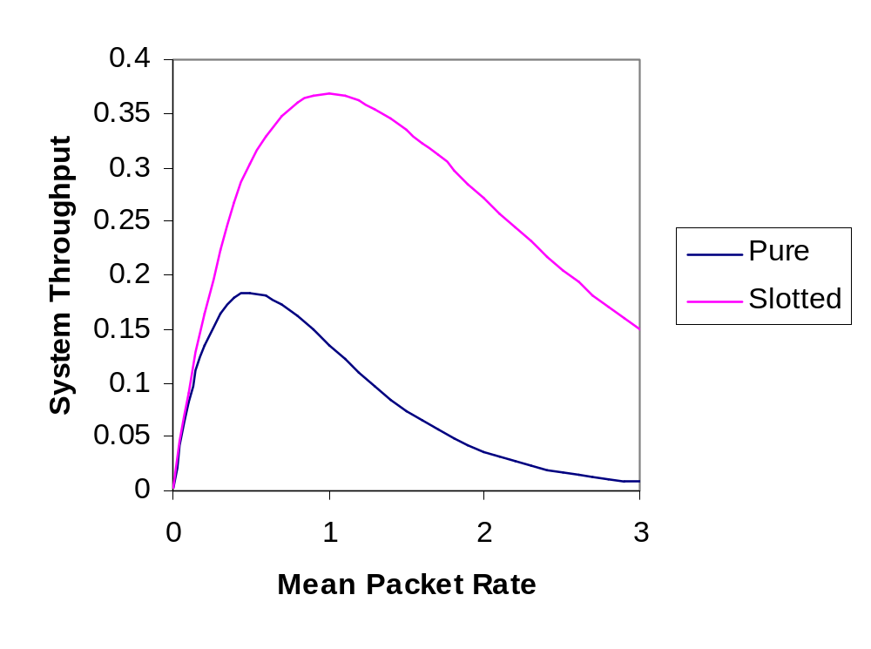
ALOHA Throughput Graph
(Offered)
Notes:
In this graph we plot the system throughput for the two ALOHA protocols. The throughput for slotted ALOHA is indeed higher than for pure ALOHA as we expected from the lower likelihood of collisions.
Note that when the system is quiet, the throughput increases linearly for both protocols and is equal up to a throughput of about 0.1.
Both protocols have a peak throughput above which the system degrades as more and more traffic is offered.
The peak throughput of the pure protocol occurs at G=0.5.
The peak throughput of the slotted protocol occurs at G=1.
Note that both protocols have relatively low system throughput. The slotted system achieving a peak of 36.8% so nearly two thirds of the available system bandwidth is unused.
This low utilisation is due to the random way that each station attempts to transmit. The way to achieve much higher utilisation is by having the stations detect the presence of traffic on the medium and waiting for a quiet time. These protocols are known as Carrier Sense protocols.

Slide 85
Carrier Sense Protocols
Improve throughput by avoiding collisions
  Sense existing traffic
  Include randomness to avoid repeated collision
Persistent vs non-persistent
  persistent protocols continuously sense the channel
  non-persistent protocols wait a random time before re-checking
Collision Detection
  avoids sending the rest of a frame once collision has occurred
Notes:
The carrier sense protocols try to avoid the simplest forms of collision where the medium is already occupied. They sense the channel to see if it is carrying traffic and only transmit during a quiet period. This does not remove all collisions as two stations could be waiting for the end of the same frame to transmit. In order to avoid them continually conflicting a random element is introduced into the protocol.
Protocols can be divided into two categories: persistent and non-persistent. The persistent protocols continuously sense the channel until it becomes free. At this point it then sends a frame (with probability 1 in a continuous time system and with probability p in a slotted system), if a collision occurs it waits a random amount of time before starting again.
The non-persistent protocols have random time intervals between sensing the channel.
These variations differ in the ‘greediness’ of the protocol in grabbing the channel. The idea is that by being less greedy, the overall channel usage goes up and the individual channels wait slightly longer to access the medium.
One other improvement that can be made is to make the transmitters stop transmitting when a collision has been detected.

Slide 86
Collision-Free Protocols
Include negotiation before transmission
  polite protocols
  transmission slots are reserved in advance
  still a system overhead
Hierarchical protocols
  all stations are not equal
Booking period
Transmission
Notes:
Collision free protocols actively manage the channel to ensure that no collisions occur. This can be done by arranging for frame slots to be reserved in advance during a ‘booking period’. Each transmission phase can be of variable length since different numbers of stations may transmit each time.
This protocol sets an upper limit on the bandwidth a single station can access which is lower than the channel bandwidth (unlike ALOHA) since even if only one station wants to transmit, it still needs to go through the negotiation procedure for each frame.
The overhead of the negotiation can be quite small. For N stations transmitting M bit frames it might be N bits for the booking period and N*M bits for the transmission period giving an overhead at peak times of
N/(N+N*M) = 1/(M+1)
Hierarchical protocols have some built in definition of the order of importance of the stations and allow them to transmit preferentially in that order. Although the reservation protocols are not very hierarchical there is still a small advantage to being last to reserve. This is due to the fact that if a low numbered station misses its reservation slot it has to wait for the remainder of this booking period and the entire length of the next one before being allowed to transmit.

Slide 87
Ethernet
IEEE standard 802.3
  1-persistent CSMA
  Collision Detection
  1-10MBit/s
  Ethernet is a minor variation on 802.3
  Media
    Coax, twisted pairs, fibres
    Manchester coding
Notes:
The IEEE standard 802.3 defines a family of 1-persistent (i.e. Always transmit when free) CSMA protocols with collision detection (stop sending a frame once a collision has occurred.
The standard describes a number of media types with transmission speeds ranging from 1 to 10 MBit/s. The commonest found in the Ethernet product (a minor variation in the definition of the frame header) is thin coax or twisted pair and usually runs at 10MBit/s.
The line coding used is usually some form of Manchester coding where essentially two physical bits are used to represent one logical bit. Of course this requires twice the bandwidth as normal binary encoding but allows the system to run without some form of global clock.

Slide 88
802.3 Frame
Bytes 7
1
2 or 6
2 or 6
2
Preamble
Begin frame
Destination address
Source address
Data length
Data
0-1500
0-46
4
Data
Pad
Checksum
Notes:
The 802.3 frame contains the following fields:
Preamble: 7 bytes containing 10101010 which constitutes a 10MHz clock to allow the receiver to synchronise to the transmitter.
Start of Frame: 1 byte containing 10101011, the first pair of ones denotes the start of the frame.
Destination and source addresses: Generally only the 6 byte version is used now. The highest order bit is used to indicate sending to a group address to implement multicasting. An address consisting of all 1’s means ‘everyone’ to implement broadcasting. The second highest bit indicates if the address is local or global. Local adressing allows you to allocate your own addresses. If you want a unique address you have to apply to the IEEE for a global address. There are 46 bits available giving an address space of 7*10¹³.
Length: specifies the length of the data field
Data: the important stuff
Pad: The 802.3 standard defines a minimum frame length for a valid frame as 64 bytes. This field is used to pad out any actual data to the minimum length. The minimum length is included so that small pieces of frame caused by collision can be identified and ignored.
Checksum: A 4 byte CRC checksum computed from the rest of the frame as discussed in lecture 4.

Slide 89
Propagation Effects
Propagation speed
  limited to c, smaller in general = v
LAN size
  allowed size, L, specifies maximum time separation, T
Packet length (bit rate =B)
  must be larger than 2T
N=2LB/v
collision
T
2T
Time
Notes:
So far we have not discussed propagation effects. To put it another way we have been implicitly assuming that the propagation time on the LAN is much shorter than the frame time.
Physically we know that signals are limited in speed to the speed of light but will be smaller than that in any medium. For example in optical fibre the refractive index is about 1.5 meaning that signals travel at about two thirds the speed of light.
As the LAN length increases we have to worry about the propagation time as this will affect the ability to detect a collision. The diagram shows a packet travelling between two stations separated by the maximum allowed length, L, on the LAN corresponding to a propagation time L/v. If a collision occurs, then it will take at least 2T/v before the transmitter hears the collision. If the transmitter had finished sending before then, it would have (incorrectly) concluded that a successful transmission had taken place. The standard therefore restricts the minimum packet length to twice the maximum propagation delay on the LAN. This gives the following relation between the LAN length, the minimum packet length (in bits) and the bandwidth
N=2LB/v
Note the minimum packet length increases with the bandwidth, this will become more and more restrictive as bandwidth requirements increase.

Slide 90
Randomisation
Need randomness to avoid collision locking
Following successful frames there is a collision
  divide time up into contention slots
  apply some algorithm until no contention occurs
X
Successful frame(s)
Contention slots
Notes:
If no randomness were introduced into the protocol there is the possibility that two stations will try to send at the same time and will then continue colliding in step for ever.
In order to avoid this we divide the time up after a collision (marked X) into contention slots whose length is set to the maximum allowed round trip delay on the LAN. Each of the stations involved in the collision then applies some algorithm until the contention is resolved.
One such algorithm is the binary exponential backoff algorithm. Following the collision each station waits 0 or 1 slot before retrying. If there is a further collision the number of slots to chose from is doubled to four and the stations try at random again. Each further collision results in a doubling of the number of slots until 10 collisions have occurred and the number of slots remains at 1024. After 16 collisions, the network is assumed to be broken.
It is important that an implementation does not try to cheat, beware of arguments based on ‘why chose the last slot’.

Slide 91
Token Networks
Originally designed for railways to avoid crashes
  access to a single line section governed by possession of a token
In LANs the token is virtual
  Token ring (IEEE 802.5), passed in one direction
  Token bus (IEEE 802.4), passed around a logical ring
MAC protocols are much more complex than for Ethernet
Notes:
The original concept for token based networks was developed in railways in the last century. The problem was the existence of single line sections of the track where trains would have to travel in both directions. After several bad accidents the token system was introduced whereby a physical token was associated with a particular piece of track. Access to that section was only permitted if the driver was in possession of the token.
Token networks work in much the same way with the virtual token giving the station that has it the permission to send frames onto the network. The MAC sublayer protocolhas to deal with the issue of how long the token can be held for, what order the token is passed around the stations, what the format of the token should be as well as the usual definitions of frame format etc. Since the token has to be passed from station to station it also needs to address the issue of what happens if a station is down.
In general the MAC protocols for the bus (802.4) and the ring(802.5) are much more complicated then for the Ethernet.

Slide 92
Next Lecture
Connecting multiple LANs
  Repeaters
  Bridges
Notes:
In the next lecture we consider the problem of extending networks.
We will discuss the use of repeaters to extend physical length and of bridges to connect LANs with different protocols such as connecting Ethernet to a Token network.

Slide 93
Interconnecting LANs
Connecting multiple LANs
  Repeaters
  Bridges
Notes:
In this lecture we consider the problem of extending networks and connecting networks of different types together.
We will discuss the use of repeaters to extend physical length and of bridges to connect LANs with different protocols such as connecting Ethernet to a Token network.

Slide 94
Repeaters
Used to connect LANs running the same protocol
cleans up signals
  receives, amplifies, re-transmits
Cannot extend total system length beyond N=2LB/v limit
Notes:
Repeaters are basically simple devices which do not perform any active function at the protocol level.
They are used to connect two LANs running the same protocol, for example two Ethernets. They consist of a receiver and a transmitter which relays the packets on one side of the repeater to the other side.
They are useful for extending the length of a LAN where losses would otherwise prevent the signals from being useful. They cannot circumvent the overall limit on the system length specified in the relevant standard.

Slide 95
Bridges
Operate within the data link layer
  do not examine network layer headers
  can deal with IP, IPX, OSI etc packets
Translate between various MAC sublayers
  e.g. 802.3 to 802.4
Applications
  necessity, limitations, demand
  isolation, security
Notes:
Although bridges are a much more sophisticated network element than repeaters they do not implement the full OSI protocol stack. They only deal with the data link and physical layers.
Since they have no knowledge of the network layer they cannot distinguish between IP and IPX packets for example. So they can transfer packets from one network to another provided they speak the appropriate data link protocol on the networks they join.
The reason they need to have a knowledge of the data link protocols is that the frame structure is dependent on the protocol and therefore the bridge will have to re-construct the header into the appropriate format.
There are several reasons why we might need bridges:
We can’t guarantee that two parts of the same organisation installing LANs will make the same choice for network infrastructure, especially as they may have different requirements for the LAN.
Bridges provide a way of getting round the limitations imposed by individual LANs such as the maximum length.
It might be the case that the total user population represents has a bandwidth requirement that cannot be satisfied by a single LAN
Bridges perform a kind of isolation so that if a LAN goes down, the other LANs to which it is bridged can still operate.
Bridges can provide some degree of security without the need for physical isolation.

Slide 96
Simple bridge application
Bridge
Bridge
Bridge
Token Ring
Ethernet
Notes:
This diagram shows a simple application of bridges in which local LANs are connected to a backbone LAN. Each bridge may know about many protocols but it must know about the protocol of the backbone LAN (which may be different to all the others) and the protocol of the local LAN it is serving.
Note in this example, a bridge is connected to a token ring and so it must be capable of holding the token. On the Ethernet it sits as a terminal peered with all the others and has to fight for bandwidth. Since the bridge cannot guarantee immediate access to the shared access medium it must have some buffers to enable it to store packets as they arrive off the backbone LAN.

Slide 97
Bridge Problems
Re-framing
Preamble
Start delimiter
Access control
Frame control
Addresses
Length
Data
Pad
Checksum
End delimiter
Frame status
802.3
802.4
802.5
Notes:
The basic problem to solve in a bridge is to do with re-framing. However, while this may sound like a simple reordering of bytes or just leaving out the ones that aren’t there, remember that different MAC protocols have different functions and different definitions of some of the frame fields. For example:
All three of the 802 LANs shown here have different maximum frame lengths. If a frame arrives at a bridge which is too large for the intended LAN there is nothing that can be done since the data link layer does not provide the capability of splitting and recombining frames. We are dead.
There are nine possible LAN bridges required to cover the three standard IEEE 802 LANs shown in the diagram. Here are a few specific problems:
Token management does not exist on Ethernets. A feature included in 802.4, known as temporary token handoff, allows the token holder to temporarily give the token to the destination so that an ack frame can be sent. This process is handled by a field that does not exist in an Ethernet frame so if two 802.4 networks are bridged by an Ethernet this facility fails.
Token networks also have the concept of priority which Ethernets don’t so when going from Ethernet to a token network some guess has to be made about priority.
More details can be found in figure 4-37 of Tannenbaum, reproduced on the next slide.

Slide 98
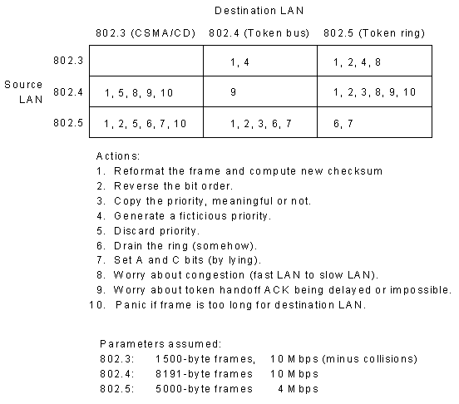
IEEE 802 Bridges
Notes:
In this diagram (from Tanenbaum, 4.37) a whole range of problems associated with bridging between two LANs are described.

Slide 99
Transparent Bridges
J
L
Bridge
Bridge
K
M
I
Routing tables
  use backward learning
Looped paths
  use spanning tree
E
A
Token Ring
H
D
G
B
F
C
Ethernet
Notes:
Here we see part of a network with three LANs connected via a backbone. If every frame on the network was simple replicated then there would be a huge amount of wasted traffic. For example, all the traffic internal to the Token ring would be needlessly duplicated on the two Ethernets. In order to avoid this the bridges use routing tables to enable them to decide if a packet needs to be sent to a particular LAN.
To make the bridges ‘plug and play’ they construct the routing tables for themselves using an algorithm called backward learning. The bridge monitors each of the LANs it is physically connected to and makes a note of the source address of every packet it sees on each LAN. Consider the bridge connected to the token ring network, every packet it takes off that network must have come from stations connected to it, so it can list all of their source addresses as belonging to the token ring (A-E). Similarly, all of the Ethernet frames that come in from the second bridge have source addresses that belong to that LAN (F-M), note that as far as the first bridge is concerned the pair of Ethernets (F-I and (J-M) look like a single Ethernet.
If the bridges do not know the destination for a particular address (either because the table entry has not been generated or because an old entry has been deleted as possibly out of date) then they resort to flooding the LANs.

Slide 100
Spanning Trees
Bridge
Bridge
Loops can occur
  construct a logical connection between the bridges which avoids loops
I
A
H
B
G
C
F
D
Bridge
Bridge
Notes:
In the example shown here, two bridges connect the same pair of Ethernets. This might be done to provide some resilience to the network. However, if flood routing has to be used we have the possibility of frames being duplicated and circulated forever.
To avoid this happening, the bridges communicate amongst themselves to construct a logical network on top of the physical network
This would result in the virtual elimination of one of the bridge links in this case. For example the logical network might look like....

Slide 101
Spanning Trees
Bridge
Bridge
Loops can occur
  construct a logical connection between the bridges which avoids loops
I
A
H
B
G
C
F
D
Bridge
Bridge
Notes:
this. The loop has now been removed by pretending the top link does not exist. Of course, in the event of a failure of the bottom link the network could be restored by reconstructing the spanning tree.
A spanning tree consists of the set of nodes with sufficient links to connect all the nodes without inducing a loop in the system. One way of constructing the spanning tree is as follows: Take each link in turn, does removing this link leave the network fully connected? If it does, remove the link and start again. If not replace the link and move on to the next link.

Slide 102
Next Lecture
Network Layer
  Relation to the Transport layer
  Routing
    static
    dynamic
    algorithms
Notes:
This concludes our study of the data link layer. In the next lecture we will start looking at the network layer. This is the highest layer that exists in network based routers and is mainly responsible for ensuring that packets get from the source to the destination.
We begin by looking at the relationship with the transport layer and the services it supplies to that layer.
We will then look at the problems of routing on a network and see how the paths are built up. We will also look at the way the network responds to problems such as router crashes, link failure and topology changes.

Slide 103
Network Layer(1)
Network Layer
  Relation to the Transport layer
  First layer to worry about end to end routing
  Routing
    static
    dynamic
    algorithms
Notes:
We have now studied the data link layer. In this lecture we will start looking at the network layer. This is the highest layer that exists in network based routers and is mainly responsible for ensuring that packets get from the source to the destination.
We begin by looking at the relationship with the transport layer and the services it supplies to that layer.
We will then look at the problems of routing on a network and see how the paths are built up. We will also look at the way the network responds to problems such as router crashes, link failure and topology changes.

Slide 104
Relationship to the Transport Layer
Transport Layer
  only exists on source and destination machines
  this is the interface to the customer
Services
  provides network addresses
  isolates user from issues like subnets, network types, topology
Delivery
  connection-oriented
  connectionless
Notes:
The data link and physical layers are all about getting data across an individual link in a communication network. The network layer is the first layer that addresses the larger problem of ‘how do we get the data from the source all the way to the destination?’. It provides an addressing service to the transport layer which allows all the possible destinations to be uniquely named. It also offers to arrange delivery of packets to any desired destination. In any given (point to point) communication between users on a network there are only two transport layers involved, one in the host machine and one in the destination machine. The interface between the network and transport layers is often the customer interface where issues such as charging and quality will be negotiated.
One goal of the network layer is to isolate the user from the details of the network such as the type of network the destination is on and the route by which the information will flow. As far as the transport layer is concerned, there are only two computers in the world and they have a direct line between them.
The major issue in the interface with the transport layer is whether the transmission should be connection-oriented or connectionless. The two sides of the debate are normally computer users and telephone operators. Telephone calls have always been connection-oriented and the phone companies want to carry on that way (so they can charge more). Computer users are generally cynical about network quality and will build in safeguards into their applications so why bother to ask for a reliable service. Here is a major difference between ATM and TCP/IP.

Slide 105
Subnet Operation
Connection-oriented
  virtual circuit (VC)
  route chosen in advance and is static, state information stored
  packets are labeled by VC
Connectionless
  no specific route
  packets carry full destination address
  no state information
Notes:
In a connection oriented subnet, the route is specified in advance by setting up a virtual circuit. This is done by making all the intermediate network layers pretend they are a telephone system. As the route is built up each node stores information about the incoming line (LAN) and outgoing line (LAN) of the virtual circuit and stores that information for use during the life of the circuit. The packet is then labeled by the name of the VC which can be much shorter than the destination address. The routing of packets is very simple since the size of the routing table is the number of VCs in existence (on a given router) not the total number of destinations.
In a connectionless subnet, the route is not specified and different packets may follow different paths. There is no setup phase, as there is for a VC, so transmission can start immediately and routers do not have to store any additional information about routes. The packets must carry the full destination address and the routing table look up is correspondingly longer.
The use of VCs implicitly relies on the reliability of the network so if a problem occurs it can be much more difficult to recover from.

Slide 106
Routing
fundamental router decision
  which output do I place the packet on?
  In general more than one output is possible
Optimisation
  need to define what we are trying to optimise
Notes:
When a network is built, we do not want to sit down and work out where everything is and then supply this information to all the routers and bridges on the network. Apart from being a tedious operation it is practically impossible when you consider a network the size of the internet, which can change in size and connectivity very rapidly. We therefore have to design the routers to be able to work out for themselves all the necessary information.
The fundamental decision is illustrated in the slide. A packet arrives on one of the input lines to the router and we need to know which output line it should be placed on. In a highly connected network there will be more than one output which will enable the packet to reach its ultimate destination but even if we have identified the possible output lines we would probably want to chose the best one. Now we have to decide what we mean by ‘best’.
Here are some possible definitions:
shortest time from source to destination
least number of routers passed through on the network
lowest level of congestion
lowest cost
highest quality of transmission
In general we may want to optimise several of these properties which means deciding how to weight them against each other. This can be done by defining a penalty function which should be minimised when optimality is reached.

Slide 107
Sink Trees
Optimality principle
  if route ABC is optimal from A to C then AB is optimal and so is BC
  independent of definition of optimal
Sink Tree
  set of optimal routes to a given destination
Notes:
The optimality principle is a very simple result which says that if I know a particular route is optimal then all the sections of that route are also optimal. If this was not the case we could replace a sub-optimal section with a new optimal route but that would be better for the whole route, contradicting the assertion that the whole route is optimal. The reason this is important is that if we have built up an optimal route between two nodes then we have obtained a lot of other optimal routes in doing so.
A sink tree is defined as a spanning tree of the network which defines the optimal routes to a particular node.

Slide 108
Sink Tree example
Notes:
In this slide we show how a sink tree can be built up.
First a node is picked at random, in this case the red node.
Next we identify its neighbours by following the links from it, here we get to the two green nodes and we include the links by which we reached them.
Next we proceed out on those lines from the nearest neighbours which are not on the tree to reach the second nearest neighbours, shown in blue and again including the links by which they were reached.
Next we proceed out on those lines from the second nearest neighbours which are not on the tree to reach the third nearest neighbours, shown in black and again including the links by which they were reached. Note that the third nearest neighbour in the centre is reachable by two links at this point but only one of them (picked at random) is included in the tree.
Finally we proceed to the fourth nearest neighbour, the final node shown in orange, where we include only one of the links by which it was reached.
The final spanning tree we have obtained defines a sink tree for the red node which specifies the optimal paths where optimality is defined as the number of hops in the network. Had we used a different definition of optimality we would have obtained a different sink tree.

Slide 109
Dijkstra Algorithm
the method used in the previous slide is known as the dijkstra algorithm
  pick a source node
  send out packets using flood routing
  packets accumulate route penalties as they pass from node to node
  if a packet arrives which is more optimal, flood it out but not back along the link it arrived on
  the packet with the lowest penalty at a node defines the optimal path
Notes:
The method used in the previous graph is an example of the Dijkstra algorithm. If we want to implement this on a network we could do the following to obtain the optimal paths to the red node.
The red node floods test packets to its neighbours which modify and flood the packets out in turn.
Each node follows this procedure: When a test packet arrives the current value of the penalty function to be used is added to the value currently stored in the packet. The node then floods the modified packet out except on the line by which it arrived. The node also makes a note of the link that packet arrived on, that it was from the red node (originally) and the value of the penalty function. If a test packet arrives and the new value of the penalty function is larger than one already seen, the test packet is discarded.
At the end of this process the generation of modified test packets will end and the sink tree for that definition of optimality will be known.
Note that at this point the red node knows nothing but all the other nodes on the network know everything they need to know in order to route packets optimally to the red node.
When each node has been through this procedure, the routing information for the entire network is known.

Slide 110
Static vs Dynamic Routing
Static routing
  routing tables loaded from ‘outside’ the network
  routing tables set up on initialisation
Dynamic routing
  Routers regularly exchange information
  Optimum routes constantly updated
In practice the only difference is one of timescale
Notes:
There are generally considered to be two forms of routing, static and dynamic. Static routing is where the routing tables are set up once and for all and dynamic routing is where the routing tables are modified during the operation of the network. Tanenbaum considers the Dijkstra algorithm to be static although the example we discussed clearly shows that it can be dynamic. There is even a comment in his book that the algorithm could be applied regularly! So called static tables have to be capable of being modified, albeit perhaps on a very long time scale, to allow for network problems and growth.
The main difference between these two approaches would therefore seem to be one of timescale rather then one of principle.
However, since the terminology is in wide use we had probably better stick with it.

Slide 111
Dynamic Routing
Fast
  rely on nearest neighbour information
  compare notes regularly
Distance vector routing
  nearest neighbour information known
  for each router store, link to be used & estimate of ‘distance’
  modify link and distance by comparing with neighbours
  poor response to router failure
Notes:
Given that we want to do ‘dynamic’ routing we assume that it is to be fast so that the network can react quickly to router failures or topology changes.
If the routing updates are to be fast then it is reasonable to try and restrict the information exchanges to nearest neighbours so that they can regularly compare notes on their current knowledge of the routing.
One such algorithm is Distance Vector Routing. The routing table, at each node, contains an entry for each router on the subnet which specifies the link to be used to send to that router and the estimated value of the penalty function being used to define optimality which for simplicity we will still call distance.

Slide 112
Distance Vector Routing
A
Distance to node A
X
B
?
?
4
1
1
W
W
1
1
1
2
2
2
X
?
2
2
1
Z
Y
Y
2
2
2
B
Z
?
4
4
Notes:
Here is an example of the distance vector algorithm working on the route from A to B. For simplicity, we will only look at the two shortest routes involved, BXWA and BZYA.
The table shows the current estimated distance to node A of all the routers involved. Each column corresponds to a single iteration of the algorithm. In general, the updates will not be synchronous.
Initially only nearest neighbour distance are known. So only nodes W and Y have an entry pointing to A. Note we are also ignoring the storage of the information about the correct link to use here.
At the next iteration the nodes exchange information with their nearest neighbours. Clearly, only W and Y have any information at the moment and this is passed on to X and Z respectively. X can now update its information since W announces a route to A of length 1 and W is a distance of 1 away, X now knows of a route of length 2. Similarly, Y announces to Z a route to A of length 2 and since Y is a distance of 2 from Z , Z now knows of a route to A of length 4.
At the final iteration X and Z both announce to node B routes to A of length 2 and 4 respectively. B now knows that the shortest route to A is via X and is of length 4.

Slide 113
Count to Infinity
What happens if node A disappears?
A
Distance to node A
X
B
4
4
6
6
1
W
W
?
3
7
5
2
2
X
2
6
4
8
1
Z
Y
Y
?
6
7
7
B
Z
4
5
5
7
Notes:
This slide illustrates the count to infinity problem that occurs when a node (or link) goes down.
The first column shows the initial state of the routing table immediately after node A disappears. Nodes X and Y no longer have a path of length 1 but all the others believe the network is still as it was.
At the next iteration X announces to W a path to A of length 2 so W deduces (incorrectly) that it can get to A in a path of length 3 (through X). Similarly, Z announces a path to A of length 4 so Y deduces a path to A of length 6 (through Z).
At the second iteration, B chooses the smaller of X+2 and Z+1 (values taken from the previous state) and the other nodes continue to update their tables taking the smallest route offered through their neighbours.
As the iterations proceed the routes generally increase in length and will continue to do so as no valid path exists in reality.
Although this protocol was originally used in ARPANET it was eventually superceded due to its slow convergence in situations like these, even with modifications.
In practice a link state algorithm is used where each router gathers information about its links and neighbours and then sends this out to all the other router. Each router can then apply a local version of Dijkstra to compute the shortest paths. The problem with this is that it scales very badly as the number of routers involved increases.

Slide 114
Hierarchical Routing
Link state algorithms
  scale badly with network size
  large overhead in traffic
divide network up into levels
  e.g. {Countries} and {Routers in a Country}
  each router stores information about other routers in its own country and one router in all other countries
  can be more than two levels
  optimum number is ln(N)
Notes:
Link state algorithms, where full information on the network topology is gathered and distributed throughout the entire network, scale badly when the network grows very large.
One way around this problem is to use hierarchical routing. As a simple example consider an addressing scheme which includes the country of origin of the router. All the routers in a given country store complete information about each other in the usual way. If a packet arrives for a different country the router only needs to store the information for a path to a single router in that country. This can drastically reduce the memory required for the router table.
In general it is possible to have a multi-level hierarchy. The optimum number of levels in an N router network is lnN. As we shall now see.

Slide 115
Optimal Hierarchies
Branching of x at each level
p levels of hierarchy
N = x^{p}
Entries E(x) = xp = xln(N)/ln(x)
Optimum when dE/dx = 0
dE/dx = ln(N)/ln(x)-ln(N)/ln(x)²
0 = ln(x) - 1 or x = e
hence p = ln(N)
Notes:
If we assume the hierarchy is uniform so that each level has x members in the lower level. We will have p levels so the total number of routers in the network is x^{p} which we call N. Note N is fixed in this calculation.
The number of entries in the router table is x for each level so the total number of entries in a router table E(x) is xp.
The optimum value of x can now be found by differentiating this expression with respect to x while keeping N fixed. This establishes the optimum number of levels as ln(N) and hence the number of router entries as e ln(N) which is much smaller than N.

Slide 116
Next Lecture
Congestion
  global network problem
Flow control
  point to point problem
Notes:
In the next lecture we will look at congestion and flow control.
Congestion is a global network problem and results from the behaviour of large numbers of hosts. The simplest example is a shared access medium where too many stations are trying to transmit at the same time.
Flow control is the regulation of flow between two points to accommodate the variable bandwidths and processor speeds that can be encountered over a route.

Slide 117
Network Layer(2)
Congestion
  global network problem
Flow control
  point to point problem
Notes:
In this lecture we will look at congestion and flow control.
Congestion is a global network problem and results from the behaviour of large numbers of hosts. The simplest example is a shared access medium where too many stations are trying to transmit at the same time.
Flow control is the regulation of flow between two points to accommodate the variable bandwidths and processor speeds that can be encountered over a route.

Slide 118
Congestion
Full Capacity
Perfect operation
Throughput
Acceptable operation
Congested network
Offered Load
Notes:
In this graph we show the network throughput achieved as a function of the load. The dotted line shows the maximum capacity that the network can achieve.
The green curve shows the ideal operation. The throughput increases linearly with the load until the full capacity is reached. After that the full capacity is maintained even through more packets are offered to the network.
The blue curve shows a situation which is acceptable. The throughput increases linearly at low loads but starts to tail off as the offered load approaches the full capacity. The throughput increases monotonically and the maximum throughput is approached asymptotically at large network loads. In practice this is about the best that we can hope for.
The red curve shows a situation that can occur in practice. The throughput initially increases linearly but reaches a peak and then starts to degrade. As more and more packets are sent into the network fewer and fewer are delivered. At this point the network is so full of management overhead packets that very little data can get through. We have seen a simple example of this in shared access LANs using the ALOHA protocol where the collisions dominate at high loads.

Slide 119
Open Loop Control
No measurement of network state
  Designs which attempt to avoid congestion
    When to accept new packets
    When to offer new packets
    When to give up and discard packets
    How to schedule when contention occurs
    Routing algorithm
  Influence of other layers
    data link layer timeouts
Notes:
Taking some terminology from control systems, our first method is open loop control. No measurement of congestion in the network is made and no feedback loops are set up to manage it. In this case, the approach to avoiding congestion is to attempt to design it out of the system as much as possible. This is clearly a desirable thing to do even if we intend to build in controls systems.
The sorts of decision that can be made are shown in the slide. Consider the issue of when to offer new packets. It turns out that data traffic is bursty (non-poissonian) which means that statistical averaging does not occur. High bandwidth lines carrying aggregated traffic still suffer from large fluctuations and are likely to saturate. On way to avoid this is to regulate the number of packets offered, this is known as traffic shaping.
All of these things can affect the way the network responds when the load increases and therefore can affect the likelihood of congestion occurring.
The choice of routing algorithm can also have an important affect. Different penalty functions can give rise to different path distributions.
The design of the data link layer can also affect network congestion. For example, the timeouts selected for packet retransmission should not be less than the round trip time or the number of packets sent will be doubled (at least).

Slide 120
Traffic Shaping
Leaky Bucket algorithm
  Variable input rate
  Constant output rate
  Size of buffer ‘= bucket’ is important
  Statistics of input flow are important
Data
Buffer
Notes:
The leaky bucket algorithm is a traffic shaping mechanism mostly used in virtual circuit subnets (such as ATM). The bucket corresponds to a buffer which can accept data at a variable rate and is hopefully long enough that no overflow occurs. The actual length required is largely determined by the statistics of the data source and the output flow rate. At regular intervals, a fixed amount of data is taken from the buffer and sent onto the network. If nmo other data the buffer gradually empties.

Slide 121
Traffic Shaping
Leaky Bucket algorithm
  Variable input rate
  Constant output rate
  Size of buffer ‘= bucket’ is important
  Statistics of input flow are important
Buffer
Notes:
More data is now on the network and the buffer is emptying.

Slide 122
Traffic Shaping
Leaky Bucket algorithm
  Variable input rate
  Constant output rate
  Size of buffer ‘= bucket’ is important
  Statistics of input flow are important
Buffer
Notes:
Most of the original message has now been sent.

Slide 123
Traffic Shaping
Leaky Bucket algorithm
  Variable input rate
  Constant output rate
  Size of buffer ‘= bucket’ is important
  Statistics of input flow are important
Data
Buffer
Notes:
More data has now been queued and the buffer is now much fuller. Data continues to be sent.

Slide 124
Traffic Shaping
Leaky Bucket algorithm
  Variable input rate
  Constant output rate
  Size of buffer ‘= bucket’ is important
  Statistics of input flow are important
Data
Buffer
Notes:
The first message has been sent and the second message has reached the start of the queue. However, new data has arrived again and the buffer is close to overflowing. If it should overflow we would have to discard packets.

Slide 125
Closed Loop Control
Since we need to measure congestion in order to apply feedback, we need to define it.
  Line utilisation
  Buffer utilisation
  End to end delay (relative to quiescent conditions)
Need feedback algorithm
What about multiple feedback loops?
Notes:
If we want to use some form of active feedback to control the network congestion then we must have some definition of what it is and some way of measuring it. Various definitions can be used for example the degree of line utilisation (current occupied bandwidth/maximum bandwidth). The degree of buffer utilisation (current size/maximum size). The current end to end delay can also be used although it is only relevant when compared to the delay under low low network loads (which we can never guarantee to measure since we don’t in general know how the packet is getting there and what the network is doing along the way). Note the first two definitions of congestion are local properties which we can guarantee to measure while the last is a global network property and much more difficult to assess.
Clearly, we also need to specify what we are going to do on the basis of the measurement we have chosen.
There is also the issue of what happens when many independent feedback mechanisms are in operation at the same time.

Slide 126
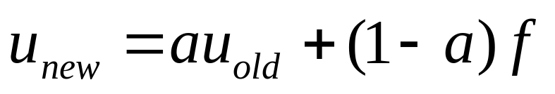
Moving Averages
Utilisations will fluctuate on many times scales
  want to avoid responding to short time congestion
  need to use a moving average, f is current indicator
  parameter a and the sampling time T determine the averaging time
  set a threshold level on u to determine when congestion has occured
Notes:
In order to avoid continuously turning on and off congestion control mechanisms it is usual to use some kind of averaging. A simple moving average method is shown in the slide. At occasional intervals a sample of the congestion is taken and a decision is made as to whether the network is currently congested or not. If it is we set f=1, if not we set f=0. The formula is then used to compute a new value of the moving average u. The coefficient a is a parameter which can be between 0 and 1 and characterises the memory timescale.
If a is 0 then there is no memory as u always takes on the current value of f.
If a is 1 then there is an infinitely long memory and u always remains at its initial value.
In between u is an average over a range of previous values of f.
We will now look at a spreadsheet which simulates the operation of this moving average in a network with Poissonian traffic statistics.

Slide 127
Choke Packets
When congestion has occurred e.g. on a particular line
  note destination and source of packets on the line
  send a packet to the source telling it to back off sending to that destination
  mark packet to prevent it generating further choke packets
  when a source receives a choke packet it reduces the flow, typically by a half
  having reduced the flow, it then waits for a while before adjusting the flow again
Notes:
The choke packet is sent from a router to all the sources of data associated with the congestion. The sources respond by reducing the flow by about a factor of two which would mostly remove the congestion. However, this is not guaranteed as there can always be new hosts trying to transmit and these can have the effect of constantly bringing the congestion back above threshold. A source trying to complete a long transfer can be strongly hindered by lots of sources completing small transfers.
The reason for marking the packet as a choke packet is that we do not want routers sending out choke packets to other routers and having the generation of these packets spiral out of control by creating more congestion. Remember that when choke packets are first created they represent an increase in network demand and in the worst case this can lead to a reduction in throughput.
One problem with this technique is that it requires the sources to implement the backing off of the flow. In order to put the control more squarely in the hands of the router they often use queuing algorithms.
Another problem stems from the global scale of networks. It can take a long time for a choke packet to reach the source. If the source is a fast machine it may have already sent a huge amount of data into the network.

Slide 128
Hop by Hop Choking
Make intermediate routers respond to choke packets
  Can do so by increasing buffer usage
  increasing buffer usage can lead to increased congestion
  different flows are essentially interacting with each other
R1
R2
A
B
C
D
Notes:
In order to get round the potentially long timescales associated with waiting for a source to reduce the flow, it is possible to ask routers along the route to respond to choke packets. This has a much more immediate effect on the congestion at the original point. In order to do this while not losing data the intermediate routers must increase their buffer usage until the source eventually responds by reducing the flow. Since buffer utilisation is one possible measure of congestion the net effect is to spread the congestion over a larger number of routers. Under high loads this can have the effect of generating congestion in flows which were not involved in the original problem.
Consider the simple situation shown in the diagram. A is sending to B and C to D. Congestion is detected on the line from router 2 towards B and router 2 begins sending choke packets back to router 1. Router 1 reduces the flow and starts to use more buffers but before A can respond, router 1 detects congestion associated with the output buffer toward router 2. Since C and D are communicating via that link, router 1 starts to send choke packets to C even though the route from C to D was not initially congested.

Slide 129
Fair Queueing
Queue for source A
Line 1
Queue for source B
Queue for source C
Queue maintained for each source and each line
Router scans the queues sequentially for packets to send
  unfair on sources sending small packets
  implement packet division
  use weighted fair queueing
Notes:
One way of giving more power back to the routers is to use a form of fair queueing. In this technique a router maintains a set of queues from its input lines to its output lines. It then uses some algorithm to determine which packet to service next. The simplest is a round robin service where the queues are scanned sequentially for packets to transmit. Since this gives an unfair advantage to bigger packets on the network it can be modified to deal with the packets in smaller chunks.
Another modification is to allow different sources or types of traffic to have different priorities. This sort of approach is particularly useful when attempting to balance the load between best effort and other sorts of traffic in order to implement some form of quality of service.

Slide 130
Load shedding
When all else fails
  dump some packets
    at random
    depending on application
      file transfer
      audio stream
Notes:
Ultimately there may be just too much traffic to be able to get it all through. When this happens the routers have no choice but to lose some packets and allow the source and destination nodes to deal with it. If the stream was unacknowledged, the packets are lost forever. If the stream has some form of control then a retransmission will be tried at a later time.
The router needs to decide how to choose which packets to drop. The simplest approach is to pick packets at random. If the router knows something about the traffic it might be possible to make a more intelligent choice.
For example, suppose a particular stream was a real time audio feed. These services usually use an unacknowledged packet format since missing packets might be irritating to the listener but do not generally render the transmission unusable. Under these circumstances the router could lose older packets in preference to newer ones.
If, however, the service was a file transfer where the arrival of each packet is critical the router might choose to lose newer packets in order to avoid retransmission of large numbers of packets.
Note that in order to implement an intelligent discard policy, the network layer needs to have some knowledge of the message content. Not something that is really supposed to happen in the layered model!

Slide 131
Next Lecture
Internetworking
  Concatenated virtual circuits
  connectionless internetworking
  fragmentation
  IP
  Controlling the internet
Notes:
In the next lecture we will look at internetworking. This aspect is defined as the set of problems that occur when many different protocols are used in different parts of the network.
Internetworking can be achieved using virtual circuits by stringing them together from end to end or in a connectionless way through datagrams. We will concentrate on the datagram approach and leave the virtual circuits to the ATM lectures.
We will consider the problem of fragmentation which occurs when networks are connected with different maximum packet sizes.
We will also discuss the Internet Protocol (IP), how it is structured and the addressing scheme it uses.
Finally we discuss some of the protocols used to control the internet.

Slide 132
Internetworks
Internetworking
  Concatenated virtual circuits
  connectionless internetworking
  fragmentation
  IP
  Controlling the internet
Notes:
In this lecture we will look at internetworking. This aspect is defined as the set of problems that occur when many different protocols are used in different parts of the network.
Internetworking can be achieved using virtual circuits by stringing them together from end to end or in a connectionless way through datagrams. We will concentrate on the datagram approach and leave the virtual circuits to the ATM lectures.
We will consider the problem of fragmentation which occurs when networks are connected with different maximum packet sizes.
We will also discuss the Internet Protocol (IP), how it is structured and the addressing scheme it uses.
Finally we discuss some of the protocols used to control the internet.

Slide 133
Concatenated VCs
destination
source
Network 2
Multiprotocol
router
Network 1
VC1 between source and router
VC2 between router and destination
router maintains knowledge of connectivity
Notes:
In this slide we illustrate the concept of concatenated virtual circuits. Two networks are connected by a multiprotocol router. The router speaks both network protocols (e.g. X.25 and ATM).
Initially the source sets up a virtual circuit to the router. The router then determines the path to the destination and sets up a VC to the next router (in general). In this simple case the VC is set up with the destination. The two virtual circuits are quite independent. It is up to the router to maintain the state information which connects the two.

Slide 134
Connectionless Internetworking
destination
source
Network 2
Multiprotocol
router
Network 1
Notes:
Datagrams are constructed and sent in the usual way. Routing decisions are made on a packet by packet basis so that we cannot even guarantee that all the packets in a message will be sent over the same set of networks. Since each of the networks can have different properties the processing that the packets receive will be different depending on the route they took.
Since each network will have its own network layer protocol we cannot simply transfer network layer packets across the routers. One possibility is to try and convert from one protocol to another but this is not very successful for much the same set of reasons that converting between the different frame types of the 802 ethernets was difficult.
A major issue in transferring from one network to another is that of addressing. In general different networks use different addressing schemes. One possibility would be to assign every host an address for every sort of network but apart from being inefficient (lots of addresses would never be used) it would also require a huge translation table to be kept.
What IP (Internet Protocol) attempts to do is do define a universal packet which can be carried across all networks. Of course others have also had this idea so there are several ‘universal’ schemes and these have to be dealt with as well.

Slide 135
Tunneling
Useful when source and destination use same network type
destination
source
Network 2
WAN
Network 1
The WAN acts as a virtual circuit connecting the two routers
Notes:
One scheme which works well and is often used is known as tunneling.
This can be used when the two end networks are of the same type. A typical example might be two ethernets connected via an ATM network. The multiprotocol router knows that it can transfer the IP packet unchanged between the two networks so it can simply put it in some form of frame and then send it to the router of the destination network. The WAN then has the appearance of a serial link between the two networks.

Slide 136
Internetwork Routing
Routers on a network can be connected using normal procedures
  interior gateway protocol
Routers also need to know how to route amongst themselves
  exterior gateway protocol
C
A
C
A
B
D
B
D
F
F
E
E
Router connectivity
Networks and routers
Notes:
At the network layer we want to be able to get information from router to router on the way to the destination network. In order to do this we need to know two things.
How do I get to another router on this network?
How do I get to routers not on this network?
The first question has already been addressed since the routing between two routers on a network is the same as the routing problem between two hosts on a network. This is usually known as the interior gateway protocol and can be different on different networks since only information local to that network is needed. In an IP network the protocol used is OSPF (Open Shortest Path First)
The problem of routing between routers not connected by the same network is solved using the exterior gateway protocol. In an IP network the protocol used is BGP (Border Gateway Protocol). The graph that connects the routers looks quite different from the network. This is because routers connected to the same network can be considered to be directly connected to each other for the purposes of inter-router routing.

Slide 137
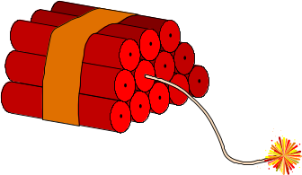
Fragmentation
When a packet is too big to travel across a network it must be broken up into manageable pieces
Transparent
  Each network that fragments a packet puts it back together again
Non-transparent
  Fragmented packets are reconstructed at the destination
Re-construction
  need for labelling scheme
Notes:
We have already encountered the problem of packet sizes when we looked at Ethernets. The data link layer had no ability to deal with the problem and so bridges were unable to cope. The Ethernet problem was due to a different definition of maximum packet sizes. Other causes include: maximum size a router can handle, maximum length slot available for transmission, errors necessitate reducing the packet length, standards.
There are two forms of packet fragmentation, transparent and non-transparent. Each of these happens on a network by network basis. In other words, there is no end to end agreement about which process to use.
Transparent fragmentation occurs when a router splits the packet into smaller packets, sends them to the next router which reconstructs the original packet. The next network is not aware that any fragmentation has happened.
Non-transparent fragmentation occurs when a router splits up a packet and it then remains split until the destination is reached.
Irrespective of which form of fragmentation is used, it is clear that we need to be able to reconstruct the original packet from the fragments. This means that some form of labelling will have to be used.
Fragmentation is also known as segmentation.

Slide 138
Labelling Fragments
Need to specify ‘end of fragments’
Packet ‘naming’
  packet.fragment: 4.0,4.2,…..4.34
    can cause problems with retransmission
Fragment tracking
  packet.start-position
  need to define ‘elementary unit’
    small enough to go through every network
    often 1 byte
Notes:
The first thing we need to do in order to be able to reconstruct the packet is to specify the final fragment. This can be done with a single bit in the header.
One approach to labelling fragments is to give them a name in the format
“packet.fragment” where the packet part is the number of the packet in the message and the fragment part is the number of the fragment of this particular packet. If packet 4 was split into 35 fragments, the packets would be labelled 4.0 to 4.34. While this scheme is sufficient to enable the reconstruction of the original packet, consider what happens if a fragment is lost. The source has no knowledge of the fragmentation process so it can only re-transmit the original packet. However, in the datagram network there is no guarantee that the retransmitted packet will travel along the same path. So there is no guarantee that it will be split into the same number of fragments or even that it will be split at all. If it is split into different sized packets the same label would correspond to a different packet.
A scheme which will enable recovery from different fragmentations is to label the fragment “packet.start-position”. The packet part still refers to the original packet number but now the start-position field specifies where in the original packet this fragment starts. We could choose the bit number as the start position but to reduce overhead it is often better to define an elementary fragment unit and break packets up into multiples of that unit. Clearly, the unit must be small enough to pass through any network and is typically 1 byte.
Even if a re-transmission occurs and the packet is fragmented differently the host can still find the original bytes.

Slide 139
Packet Reconstruction
packet
fragment
end
Data
4
0
1
A
B
C
D
E
F
G
H
I
J
4
0
0
A
B
C
D
E
4
5
1
F
G
H
I
J
4
0
0
A
B
C
D
4
4
0
E
F
G
H
4
8
1
I
J
Notes:
Here we show some examples of the packet fragmentation process. Note that an unfragmented packet is still labelled as though it was fragmented into one fragment. This is convenient as we don’t have to change the packet header format when fragmentation occurs.
The middle pair of packets show what happens when the packet is fragmented into packets of five bytes.
The bottom triplet shows fragmentation into packets of four bytes. Note the last packet is smaller.
We can now see how this scheme allows us to recover from re-transmission. Suppose we receive the second packet of the middle pair the first time and the first two packets the second time. We are missing the last two bytes in the re-transmission but they made it through the first time. Since the positions of the bytes are known we can deduce which bytes are missing and where they are in the fragments we have. Provided every elementary unit makes it through in one of the attempts we can reconstruct the original packet.

Slide 140
Firewalls
Security vs Communication
  Business wants to ensure security of information
    contacts
    personnel
  Business wants to communicate
    connect network to outside world
firewall
Internal network
Packet filter
Application gateway
Packet filter
outside
Notes:
A problem faced by every business is the conflict between the desire for security of its company information and the desire to communicate effectively with suppliers and customers. If they connect their computer network to the outside world, they expose themselves to the possibility of hacking. They also risk their employees accessing information they shouldn’t.
The way round this is to construct what is known as a firewall. The purpose of the firewall is to regulate the type of traffic that flows into and out of the internal network. The firewall consists of two packet filters with an application gateway sandwiched between them. The packet filters simply discard packets of certain types, the types being determined by the policy of the company. For example, all attempts to use the http protocol could be blocked.
A typical example of the packet filter on the outside would be to prevent any connection requests from the outside world to prevent speculative telneting or finger access to internal machines.
The application gateway allows a more fine grained policy to be operated. For example, it could prevent http requests directed at known pornographic sites. It can also limit the size of mail messages and attachments.

Slide 141
Internet Protocol
Version
IHL
Service
Packet Length
Identification
F bits
Fragment Offset
Time to Live
Protocol
Header Checksum
Source Address
Destination Address
Options
Version 4
Notes:
The slide shows the Internet Protocol header in rows of 32 bits. The packets are sent from left to right with the high order bit going first.
The version field specifies which version of IP the datagram is using.
IHL specifies the header length (4<IHL<16) in 32 bit words.
The service field allows the host to specify the required service to the subnet.
Packet length specifies the total datagram length in bytes. Maximum 65535.
The identification field is essentially the packet number and is used by the fragmentation process. The next three bits (F bits) are: unused, DF (do not fragment) and MF (More Fragments).
The fragment offset specifies where the first byte in the fragment was in the original packet. Fragments are multiples of 8 bytes which is the elementary fragmentation unit for IP.
The time to live field is a counter which was originally meant to count down in seconds, in practice it is used as a hop counter. When this field reaches zero the packet is discarded as it is assumed to be corrupted or perhaps in a routing loop.
The protocol field specifies which process in the transport layer the packet should be handed to (TCP, UDP…). See RFC 1700.
The header checksum is formed by 1’s compliment adding the 16 bit half words before this field and taking the 1’s compliment of the result.

Slide 142
Internet Addresses
32 bits long
  written in dotted decimal notation
  0.0.0.0 to 255.255.255.255
Address classes
  Class A, 126 networks (1 byte) with 16 million hosts
  Class B, 16382 networks (2 bytes) with 64k hosts
  Class C, 2 million networks (3 bytes) with 254 hosts
  Class D, multicast
Notes:
The source and destination address fields of the IP protocol header are pretty self explanatory. The addresses are 32 bits long and usually written in dotted decimal notation of the form a.b.c.d with each decimal representing the value of one byte of the address. The possible values are 0.0.0.0 to 255.255.255.255.
The address 0.0.0.0 is special and can be taken to mean ‘me’. If a field takes the value -1 (all 1’s) then it indicates a broadcast packet. Finally addresses of the form 127.b.c.d are ‘loopback’ packets. They do not actually go to the network but are passed at the last moment from transmitter to receiver on the local machine. This feature is generally used for debugging purposes.
The IP addresses are broken up into various classes which specify what portion of the address refers to the network and what portion refers to the host.
For example, all class A addresses begin with a zero (so they constitute half of the address space), the first byte specifies the network and the last three bytes specify the host.
Class B addresses begin 10, class C begin 110 and addresses beginning 1110 are used for multicasting.
The class structure was originally designed with hierarchical routing in mind. However, the growth of the Internet has been so great that the particular structure adopted has lead to address shortages.

Slide 143
Control Protocols
Internet Control Message Protocol (ICMP)
  reporting error conditions
  testing the network
Address Resolution Protocol (ARP)
  maps physical addresses to IP addresses
  allows checking for duplicate IP addresses
Open Shortest Path First
  replaces link state protocols
Border Gateway Protocol
Notes:
IP comes with a number of control algorithms which are used to manage the network.
The ICMP contains a number of defined messages which can be used to convey information about the state of the network. It is defined in RFC 792.
‘Destination unreachable’ is returned to a source if the destination cannot be contacted. If the packet time to live field has reached zero, a ‘time exceeded’ message is sent. It is then up to the host to decide to try again or to wait until later.
‘Echo request’ is used to test whether a particular host is alive. This message is usually issued through the ping program.
‘Echo reply’ is issued in response to an ‘echo request’.
‘Source quench’ is a choke packet as we discussed in the lecture about congestion control. The host must respond by reducing the flow to the given destination.
The address resolution protocol is used to map physical addresses to IP addresses. Is can be used on networks where IP address allocation is dynamic. A machine wanting to acquire an IP address can issue an ARP request stating ‘my physical address is X, please respond with my IP address’.

Slide 144
Open Shortest Path First
‘open’ refers to the fact that it is an open standard
various distance metrics defined
dynamic algorithm
service based routing
load balancing
hierarchical
security built in
provision for tunnelled connections
Notes:
The OSPF algorithm is the latest internet routing protocol. It is an open standard defined by the IETF. It was designed for use within an ‘autonomous system’ which is essentially a network whose components share a common set of policies (e.g a company network, an ISP network). Its task is to find the shortest route between hosts with all routers being ‘equally’ usable. OSPF is a link state algorithm where the connections between neighbours are advertised to all the routers in the autonomous system. Each router then builds a directed graph describing the network and then runs the route finding algorithm.
It has a number of metrics defined such as hop count and delay.
It is a dynamic algorithm designed to respond to network problems and congestion.
It allows the possibility of using different routes depending on the type of service.
It allows load balancing by using second and third best routes etc. This also helps to relieve congestion.
It uses hierarchical routing to reduce the size of routing tables.
Security is included to prevent hackers from changing routing tables.
Explicit provision is made for tunnelled connections .

Slide 145
Border Gateway Protocol
Based on distance vector protocol
  “I can get to G in 3 hops”
Modified to include full path information
  avoids count to infinity problem
Includes ‘political’ issues
F
A
C
DEG
CG
D
G
B
E
Notes:
The Border Gateway protocol is used to establish routes between autonomous systems. It is based on a distance vector algorithm which we have already discussed. These algorithms work by announcing the ‘cost’ of getting to a destination to their neighbours. The major fault with this algorithm was the ‘count to infinity’ problem which occurs when a router goes down.
To avoid this BGP is modified to include the full path information as well as the cost (which will not be the number of hops in general).
Suppose that router E goes down in the network shown in the slide. Router D used to use the route EG to get to G so now it needs to establish a new route. A announces that it used DEG which is of no use since it goes through D itself and also it goes through E which is down. F announces it uses CG which is an open route so D now uses FCG which it will announce to A and so the new routes are gradually established.
Since BGP will generally be used when company boundaries and international boundaries are crossed it includes a political component to its routing. This allows policies such as ‘do not route through <country we are at war with>’ to be implemented.

Slide 146
Next Lecture
Transport Layer
  provides end to end transmission
  serves ‘applications’
    including session and presentation layers
Overview
TCP and UDP
Network Measurements
Notes:
In the next lecture we begin our study of the transport layer. This layer is the first layer which only exists in the source and destination machines and is concerned with providing reliable end to end data transport irrespective of the type of network actually being used. It serves the higher layers which for our purposes we will call ‘applications’ and consider this to include the session and presentation layers of the OSI model.
We begin with an overview of transport layer concepts. The following lecture will cover the TCP and UDP protocols and the final lecture in this layer will cover network measurements.

Slide 147
Transport Layer(1)
Transport Layer
  provides end to end transmission
  serves ‘applications’
    including session and presentation layers
Overview
  Services provided to applications
  Transport Service Primitives
  Sockets
  Addressing
Notes:
In this lecture we begin our study of the transport layer. This layer is the first layer which only exists in the source and destination machines and is concerned with providing reliable end to end data transport irrespective of the type of network actually being used. It serves the higher layers which for our purposes we will call ‘applications’ and consider this to include the session and presentation layers of the OSI model.
We begin with an overview of transport layer concepts.
Services
Primitives
Sockets
Addressing

Slide 148
Transport Layer
Services
  Connectionless
  Connection-orientated
Why repeat Network Layer functions
  Much of the network layer exists in intermediate routers
  routers can crash
  an intermediate network may not offer reliable transmission
  this layer is under user control
Notes:
The basic services offered by the transport layer are reliable connection-orientated and connectionless transmission. Since we discussed precisely these types of connection in the Network Layer lectures why do they need to exist in this layer?
The basic answer is the desire for internetworking across any sort of network. While ATM might offer reliable virtual circuit connections which take care of issues like packet ordering other networks do not. Remember the layer principle says you cannot make assumptions about the lower layers other than the interface definition. While your network layer may want to provide a perfect service it might have to internetwork with another one which only provided best effort transmission. So in order to satisfy the abstraction ideals we must include these functions as well as flow control and addressing.
However, this is the final layer that is involved in the transporting of data from the user of the source machine to the user of the destination machine.

Slide 149
Transport Entity
Application
Application
Transport entity
Transport entity
Transport Protocol Data Unit
Network
Network
Provides interface to user
Transport layer address
Services provided can be independent of network and platform
Notes:
The fundamental unit of abstraction in the transport layer is known as the transport entity. It may exist in either software or hardware form. It is the primary interface between the transport process and the user/application programmer. There can be many applications using the transport entity and they must each attach at a different point. These points are often known as ports and they are distinguished through their unique port number.
The addressing at the transport layer is different, in general, to the addressing at the network layer and the transport entity is responsible for providing the translation service. Routers, for example, don’t have a transport layer so they can’t have a transport layer address.
Since this is the final layer involved in the transport process it is up to this layer to ensure that the transmission requested by the user is actually achieved. One way to ensure the user gets what they really want is to establish the required quality of service (QoS) which might involve specifying a number of parameters.

Slide 150
Quality of Service (QoS)
What is quality?
  Reliability
    perfect, best effort, worst case, mean based
  Delay
    minimum, maximum, mean
  Bandwidth
    charging mechanisms, hogging
  Security
    path protection, data protection
Notes:
In order to come to an agreement over the quality of service we need some way of specifying it. There are many parameters that people worry about in specifying QoS.
Reliability of data transmission. Does it have to be perfect or will best effort be sufficient. We could also specify the worst case we are prepared to put up with or the mean behaviour we want over a session.
The delay of the packets is important in some applications, not just the mean but also the jitter. The user may want to specify a minimum and/or a maximum. Of course the propagation delay will set a limit to the minimum that can be achieved but in practice much longer delays can be caused by buffering and also by processing through the protocol stacks in the intermediate routers.
The user may want to be able to ask for a certain bandwidth. If this service is possible it would be normal to invoke some negotiation over charging to avoid resource hogging.
The user is often concerned with the security of data. Not only the possibility of it becoming available to a third party but also the guarantee of delivery through the provision of dual path routing.

Slide 151
Transport Primitives
Essentially the API offered to the user
Primitive
TPDU Sent
Meaning
LISTEN
Wait for Connect
CONNECT
Connect Request
Speak to me
SEND
DATA
Send data
RECEIVE
Wait for data
DISCONNECT
Disconnect Request
I’m finished
Notes:
A sample of possible primitives is shown here.
LISTEN takes control of the transport entity and tells it to wait for a connection. This is known as blocking since it blocks anyone else from making a connection. Since the machine is waiting for a call, no network access happens here.
CONNECT sends a request to the destination to initiate a connection. The destination would normally respond with a yes or no but how this is handled depends on the protocol.
SEND gives a data message to the transport entity which is sent across the network to the other side of the connection.
RECEIVE tells the transport entity to do nothing until some data arrives from the other side.
DISCONNECT tells the other end that the communication is finished. This might happen during a transmission (the cancel button).
This simple set would enable most applications to communicate. In practice there may be many applications running on a machine which need network access and the transport entity maintains separate links for all of them each of which can block independently. Note the message passed during a SEND operation need have no concern about network packet sizes. It is up to the network layer to get the whole message through. Of course the transport layer can break up the data from the application into smaller messages to recover from inadequacies in the network layer.

Slide 152
Berkeley Sockets
Came from Berkeley UNIX implementation
  method for allowing multiple connections
  analogy with electrical sockets with the network providing the wires connecting up the sockets.
  Applications ‘plug in’ to their socket at either end
Primitives
  SOCKET
  BIND
Symmetric release
Notes:
A common method of allowing the transport entity to maintain many simultaneous links to applications running on the same machine is to use sockets. These first came about in the Berkeley implementation of UNIX. The idea is that the transport entity creates a socket in analogy with the electrical socket or phone socket on a wall. It does all the work in providing the link between your socket and the socket at the destination transport entity. The network and lower layers provide the wires that connect the sockets together.
Each application in the communication effectively plugs in to its own socket which provides a virtual direct connection to the application plugged into the socket at the other end.
The main additional primitives are SOCKET which creates a socket object that the application can use and BIND which attaches certain properties, such as a port number, to the socket. The reason for splitting these two tasks is that the requirements of a server and a client are different. Clients must talk to server applications on the port specified by the server (or standard, applications can be associated with a specific port number) but the port used by the client can be any number at all.
In a connection-orientated transmission the release of the connection is symmetric, both client and server have to issue a CLOSE before the connection is terminated. Of course both sides have to worry about the possibility that the other has crashed and is unable to close the connection politely.

Slide 153
Addressing
Transport Service Address Point (TSAP)
  Transport layer address specific to an application
  e.g. (IP Address, Port number)
  Network layer addresses known as NSAPs
  Client Server model is implicit
How are TSAPs managed?
  Standardisation
  Name server
Notes:
The Transport Service Address Point (TSAP) is the address used to talk to a particular application attached to the transport entity. The need for a range of transport access points comes from multi-threaded operating systems which can run many applications in (quasi-) parallel. In the IP world this corresponds to a port number attached to the IP address of the network layer. For example, the http protocol of the world wide web is allocated port 80.
By analogy, Network addresses are sometimes referred to as Network Service Address Points (NSAP).
In all the discussion of the transport layer the client server model is implicit. When two hosts are communicating one of them is denoted the server. This host usually has an application permanently running and waiting for requests for a service. The other is denoted the client and is responsible for initiating the communication. The TSAP used by the client does not need to be standardised or known to the server in advance since it will be announced to the server at the start of the communication. The TSAP of the server does need to be known to the client or it will not know which address to use.
There are basically two ways of managing TSAPs. One is through some form of standardisation. We have already said that http uses port 80 and IP provides a number of ‘standard’ port numbers and a large range of unassigned numbers which are free for anyone to use. The second method is one step removed from this which is that a name server is used. The name server has a standardised port number. When a client wishes to use a particular protocol it contacts the name server and asks for the port number associated with it.

Slide 154
Process Server
avoids need for every possible application to be in memory
listens to ports not already occupied
identifies the appropriate application, starts it and passes port to it
Process server
Process server
user
http
http
App
80
80
79
79
Notes:
One other variation on managing ports is a process server. Instead of having all the server applications you want to offer running at one time you can have the most commonly used ones permanently running and manage the others through a proxy. In the slide we show an http server attached to port 80 and a process server watching all the other ports. When a request is made, here to port 79 which is the finger service, the process server accepts the call, starts the finger server and hands port 79 to it.
When the service has finished the server terminates and port 79 returns to the pool. Such a scheme would be most appropriate for infrequently used services to avoid the overhead of bringing the application from disk to memory.

Slide 155
TSAP Addresses
Flat
  Need translation from TSAP to NSAP (name server)
Hierarchical
  <level 1><level 2>………….<network><host><port>
  the NSAP is this without the <port>
  e.g. 132.146.45.31:80
Notes:
There are basically two forms of addressing and this applies to TSAP addresses.
A flat scheme is where the TSAP address and the NSAP address have no logical relation to each other. The translation from TSAP to NSAP is achieved through a name server (possibly in addition to the name server relating applications to TSAP ports).
A hierarchical scheme consists of a sequence of address specifiers with each one reducing the set membership until a unique TSAP is found. To obtain the NSAP from this address we simply remove the port number.

Slide 156
Dis/Connection Management
The Problem
  Networks are not perfect
    variable delay, packet loss, hosts crash
  Messages can be duplicated
    possible duplication of transactions
The solution
  There isn’t one
    recursive sequence of acknowledgements
  Need small probability of error
Notes:
One of the important parts of communication is connection management. Ideally two hosts want to agree that they are going to communicate, swap all the data they want to and then agree that they have finished communicating so that they can release the link.
The non-ideal properties of real networks and hosts makes this much more difficult than it sounds. The lower layers use all sorts of tricks like timers, duplicate transmission and acknowledgements to improve communication but this in itself can possibly lead to problems. In the worst case a complete message from an application could get lost, a duplicate get through and be processed, the original reappear and cause a duplicate to be processed. If this were an FTP upload then there is not much to worry about apart from the waste of time, if it were a financial transaction you might be rather more concerned.
So what can we do? Well there is no perfect solution to the whole connect/communicate/disconnect process. It is not difficult to see that acknowledgements don’t solve the problem. If both hosts need to know and agree on the current stage of the process then a host sending an acknowledgement needs to know it got through, this means the sender needs to acknowledge the acknowledgement and this leads us into an infinite recursion.

Slide 157
Sequencing
use sequence numbers
  need clock that continues ticking during a crash
  use lowest k bits of clock as number
What happens when a host crashes ?
  Introduce maximum packet lifetime T
  actually build in safety factor of a few
  two processes to compare
    clock tick rate
    TPDU tranmission rate
Notes:
How then do we deal with the problem of delayed duplicates appearing?
One method we can use was discussed earlier and involves the use of packet sequencing. In order to be able to cope with a host crash we need to have some sort of memory of where the sequencing was when the machine went down. The generally used method is to have a system clock which keeps ticking during the crash and to use the lowest k bits of the clock as the sequence number.
We still need a protocol to be able to cope with the crash. Suppose we have an estimate T of the maximum packet lifetime on the internet. We would actually make this estimate rather generous by building in a safety factor of a few. Given that we know T and the rate at which the clock ticks we have some idea of which sequence numbers are around and for how long. To see what is needed we compare the rate at which the clock ticks (this corresponds to choosing the time unit of the least significant bit of the clock) and the mean rate at which TPDUs can be send by a host.

Slide 158
Choice of Clock Rate
Tick rate
TPDU rate
faster
same
slower
T
Time
Notes:
The black line shows the rate at which the sequence number clock ticks. The three coloured straight lines show the three cases of TPDU rate: faster than the clock, the same as the clock and slower than the clock. Since packets sent out now can potentially live for T seconds we need to prevent sequence numbers being used now that might be used as initial sequence numbers within the next T seconds. This gives us a ‘forbidden zone’ on the graph which is shown by the horizontal lines. The width of the zone is T seconds and the height is determined by the clock rate.
Form this diagram we can immediately see that it is impossible to have the TPDU rate faster than the clock rate since the sequence numbers immediately enter the forbidden zone. We can also deduce that the maximum TPDU rate is one packet per clock tick. Given that the protocol is going to have to work on a whole variety of platforms, it is clear that in the general case the TPDU rate will be slower than the clock rate. In other words, the sequence clock needs to be ticking somewhat faster than the maximum possible TPDU rate on a particular machine.

Slide 159

Sequence Range
Actual TPDU sequence numbers
Initial Sequence numbers
0
Time
Notes:
Given that the TPDU sequence numbers are going to increase more slowly than the initial sequence numbers we now have to worry about the finite size of the sequence number field. If we are using k bits to carry the sequence number then after 2^{k}-1 the initial sequence number returns to zero and starts to increase again. Now the TPDU numbers can enter the forbidden zone from above. At this point we have two basic choices. We could wait for T seconds before sending the next packet thus allowing the next initial sequence number to overtake us. This pause in transmission might be very undesirable especially if T is large. The second choice is to resynchronize the sequence numbers by resetting the sequence number clock.

Slide 160
Starting and Stopping
Connection
  need to agree on initial sequence numbers
  use three-way handshake
    CONNECT(seq=x)
    ACCEPT(seq=y, ACK=x)
    ACK=y
      usually piggybacked
Dis-connection
  mostly rely on timers
Notes:
In order to initiate the connection both hosts need to agree on the initial sequence numbers to be used. In order to be able to cope with packet loss or delayed packets a three way handshake can be used. The CONNECT request from host 1 is sent with a sequence number, say x. Host 2 responds with an ACCEPT TPDU giving its own sequence number, y, and acknowledging the sequence number x from host 1. Finally, host 1 sends an ACK of the host 2 sequence number y. This is usually ‘piggybacked’ onto a data packet. In other words, the first data packet sent also carries the ACK as part of the connection process.
Lost packets are dealt with in the normal way through the action of timers. Duplicate packets are dealt with through the action of this protocol as follows. If a duplicate CONNECT (seq=w) arrives at host 2, it is acknowledged in the normal way (seq=p, ack=w). However, host 1 is not expecting an acknowledgement for a sequence number of w so it issues a REJECT TPDU with an ack=p. Host 2 now knows that it can abandon all knowledge of that connection.
The dis-connection process is also a problem if you want to have a symmetric release (i.e both host agree to close before actually closing). In fact it is insoluble, as we have mentioned, as an infinite number of acknowledgements is required. In practice, the three-way handshake can be used with both sides maintaining a timer and giving up on the connection when it times out.

Slide 161
Flow Control
What again?
  Layer by layer process
  Abstraction means different layers can have different properties and resource limits and these may not be known
Multiple connections in Transport Layer
  TPDU arriving from the network layer (acknowledged and flow controlled) may be rejected due to being busy, lack of buffer space
Buffer management
  negotiation of buffer space at transport layer
Notes:
Flow control happens at the data link layer and the network layer so why should we need it yet again at the transport layer? In some ways this is a consequence of abstraction. When data link layers communicate they guarantee that packets will arrive and be offered to the network layer. Once a packet has been passed upwards in the stack the job of the lower layer is finished. If the next layer up is too busy or has insufficient resource to cope with another packet then that packet will be discarded. Thus flow control will always be an issue. The transport layer handles multiple connections for applications and can have a great deal to do in handing off packets as they arrive, sorting out the many TSAP addresses it is managing, monitoring its own internal state and communicating with a number of other transport entities. Given this, we can see that buffering and flow control will need to be addressed.
Buffer management is one way of implementing flow control in this layer. The receiver can allocate buffers to the transmitter, including zero buffers thus suspending the transmission. This is like a sliding window protocol except that the window length is variable.

Slide 162
Next Lecture
Transmission Control Protocol (TCP)
User Data protocol (UDP)
Notes:
In the next lecture we will take a detailed look at the two IP transport layer protocols TCP and UDP.

Slide 163
TCP and UDP
Finite State Machines
Transmission Control Protocol (TCP)
User Data protocol (UDP)
Notes:
In this next lecture we will take a detailed look at the two IP transport layer protocols TCP and UDP.
We begin with a brief discussion of an analysis technique based on finite state machines.

Slide 164
Finite State Machines
Finite State Machine
  List all possible states
    Idle, Connection established, sending data, waiting……
  List all possible events
    Transport protocol primitive
      Connect, Listen, Receive…….
    Incoming packet
      Data, Call_Accept, Clear_request……
    Timeout
  Construct table of actions for each (state, event) pair
Notes:
One approach which can be useful in analysing protocols is the finite state machine. The ‘machine’ is the system we are interested in analysing and it could be a washing machine or in our case a transport protocol. The idea is to classify the possible states that the machine can be in and the possible events to which the machine must respond.
For a transport protocol the states describe what the protocol is currently doing. It could be idle, waiting for something to happen. It could be sending data to the remote host. It could be listening for connection requests on a number of ports. The states can be qualified depending on conditions which are specified (known as predicates) or we could equally well describe each of these qualifications as a separate state, the choice will depend on what gives the simplest description.
The events cause transitions from one state to another and trigger actions to occur during the transition. For example, suppose a connection is set up then the protocol could be described as in the ‘established’ state. If a SEND request is initiated the transport entity may or may not have permission to give the message to the network layer depending on the flow control. Thus we would qualify the ‘established’ state by ‘allowed to send’ and ‘not allowed to send. Equally, we could describe this as two states, ‘established.allowed-to-send’ and ‘established.not-allowed-to-send’ with the transition caused by the events of the flow control.
We also have the possibility of a timeout occurring which is a special event.
Given these states and events we can construct a table and record actions to be taken in all the allowed combinations.

Slide 165
Traffic Lights
Able:
Amber
Moving
Stopped
Moving
->Stopped
->Stopped
Green
Red
->Moving
->Moving
able->Stopped
not->Moving
->Stopped
Stopped
Notes:
In this simple example we consider a car interacting with traffic lights. The states of the car are described as ‘moving’ and ‘stopped’. If the car is ‘moving’ and a red light occurs, it changes to ‘stopped’. If it is ‘stopped’ and a green light occurs, it changes to moving. This finite state machine is sufficient to control a car with no inertia i.e. one that can change its speed instantaneously. In practice, cars can’t do this and we include the amber light to allow for this.
The moving state of the car now has to be qualified. It can be ‘able to stop’ or ‘not able to stop’ with new transitions depending on the amber light. If the car is moving and an amber light is seen then if we can stop we do.
This protocol and its finite state machine description could be expanded to deal with multiple traffic lights and to deal with other cars on the road by having much more detailed states describing the moving and stopping processes.
The diagram on the right of the slide is a different representation of the finite state machine. One feature of this analysis is that it allows the identification of ‘dead ends’ i.e. states which can be entered but not left. For example, if the (Green, Stopped) action was to remain stopped, the car would never be able to leave the stopped state.

Slide 166
TCP Services
Transmission Control Protocol
  End to End control
  byte stream
  manages ordering and delivery
TSAP
  socket with a 16 bit port number
  ports below 1024 are “well known”
    e.g. 21-FTP, 23- Telnet
TCP can buffer at the transport layer
Notes:
The principle transport protocol used on the Internet is the Transmission Control Protocol (TCP). It was designed to provide a reliable end to end transmission of bytes in order over an unreliable network. IP provides very little so all the management of ordering and re-transmission is handled in this transport layer. TCP provides a byte stream which means that bytes presented to it will appear at the destination application in the order they were sent. TCP can break up and merge data bytes, maintaining their order, so no significance is given to a clump of bytes presented at one time. Applications cannot pass messages by separating them with no transmission since TCP is allowed to aggregate smaller messages into larger ones.
The TSAP addresses are sockets with a 16 bit port number. The full TSAP is given by the (IP address, port number) pair. Port numbers below 1024 are specified and are known as ‘well known’ ports. Some examples are 21 for FTP, 23 for Telnet and 80 for http.

Slide 167
Buffering Management
TCP is completely asynchronous to application messages
Two management overrides are allowed for:
  Push Flag
    forces TCP to send all data now
    flag not guaranteed to be transmitted
  Urgent Data
    forces TCP to send all data now
    interrupt generated at far end
    application’s responsibility to find urgent data
Notes:
By ‘Buffering Management’ I mean the management by the user of the ability of TCP to buffer incoming data from an application before sending it out.
Two methods have been included to allow applications to prompt TCP into sending data. Both force it into sending all the data (if any) that it currently has buffered.
Push Flag:
When an application sets the push flag, TCP flushes its current buffer to the network layer. This will still not enable message based transactions since it is not guaranteed that the push flag is sent to the destination.
Urgent Data flag:
Again the buffer is flushed to the network layer but now the urgent data flag is transmitted to the receiver. At the receiver an interrupt is generated to the application to indicate that the latest data to arrive contains urgent data. It is then up to the application to find it, although a pointer gives it the end position of the urgent data. Typically this is used when transmitting control codes which are meant to be handled immediately.

Slide 168
TCP properties
32 bit sequence numbers used
  labels data bytes
  labels acknowledgements
Maximum Transfer Unit
  maximum allowable packet size on a given network
  Maximum MTU is 65,535 bytes
  packet larger than MTU is fragmented
Sliding Window Protocol
  acknowledgement number is next expected data byte
Notes:
The TCP protocol uses 32 bit sequence numbers to label individual bytes in the message. Thus the minimum fragmentation unit for TCP is one byte. Thus both sequence number and acknowledgement numbers are 32 bits.
The Maximum Transfer Unit on a network specifies the maximum packet size that can be transmitted on that network. If a number of networks are crossed on a path between two hosts than the smallest MTU is known as the path MTU. The largest allowable MTU is 65,535 bytes and is related to the maximum packet size of IP. If a packet is larger than the local MTU, it is fragmented as we have previously described.
TCP uses a sliding window protocol where the size of the window is advertised in the acknowledgements. If the window size is zero then the source must stop transmitting until a nonzero window size is passed to it.

Slide 169
TCP Header
Source Port
Destination Port
Sequence Number
Acknowledgement Number
Flags
Window Size
HL
Checksum
Urgent Pointer
Options
Notes:
The TCP header is a minimum of 20 bytes (five 32 bit words) and a maximum of 60 bytes. The fields, in order, are:
Source and Destination ports:
Each is a 16 bit field which specifies the port number used at either end. Ports above 1023 are free for use by the hosts, ports below 1024 are the ‘well-known’ ports.
Sequence and Acknowledgement numbers:
Each is a 32 bit field, the sequence number specifies the position of the first byte in the datagram within the message and the acknowledgement number is set to the next byte expected by the receiver.
HL:
This is the TCP header length in units of 32 bit words. It allows the use of a variable length options field after the fixed 20 byte part of the header.
Un-named:
Unused, presumably included initially to allow more options to be included in future (possibly to rectify problems) but has never been used.
Flags, contains six single bit flags:
URG (urgent), =1 if the urgent pointer is in use which in turn specifies the byte offset within the payload of the urgent data.
ACK (acknowledgement), =1 if the acknowledgement field is valid.

Slide 170
TCP Header
Source Port
Destination Port
Sequence Number
Acknowledgement Number
Flags
Window Size
HL
Checksum
Urgent Pointer
Options
Notes:
PSH (push), = 1 if the data has been pushed. I.e. The source wants this passed to the receiving application as soon as possible (immediately).
RST (reset), =1 if something has gone wrong. This flag is used to reset a connection if something has gone wrong, it allows the sequence numbers to start again as might be needed after a crash. It is also used to refuse connections or to reject invalid segments.
SYN (synchronize), is used for establishing connections in combination with the ACK bit as a pair (SYN, ACK). Connection request uses (1,0) and connection accepted has (1,1).
FIN (finished), =1 indicates that the sender has no more data to send. It can, however, still receive data and the connection remains in place until both sides have issued a FIN.
Window Size:
This specifies the current size of the available window starting from the byte specified in the acknowledgement number. If the window size is set to zero then the source must stop transmitting. The flow can be re-started by re-sending an ACK message with the same acknowledgement number and the new window size.
The options part is used to enable extra facilities. These can include, announcing the host’s maximum acceptable TCP segment size (a different question from the network MTU), variations on window size and missing data protocol.

Slide 171
Checksum
Prepend pseudoheader
Source Address
Destination Address
0 0 0 0 0 0 0 0
Protocol=6
TCP segment Length
Transmitter: form 1’s complement addition of 16 bit words (with checksum=0) then take 1’s complement of result.
Receiver: form 1’s complement addition of all 16 bit words, result should = 0.
Notes:
Checksum:
This is performed on the TCP header and data and the pseudo header shown in the slide. The reason for doing this is that the checksum in the IP header does not include the network addresses.
Note that this is a violation of the layered abstraction principle since the address included in the TCP checksum belong to the network layer and not the transport layer.
The transmitter performs the 1’s complement addition of the 16 bit half words in the TCP segment, including the pseudo-header, with the checksum field set to zero. The checksum is then set to the 1’s complement of this result.
The receiver performs the same calculation but includes the checksum, the result should be zero as we will now show.
Suppose the result of the transmitter sum without the check sum is X. Since we specify the checksum to be zero the 1’s complement addition of all the fields is still X, the 1’s complement of X is -X and this is the transmitted checksum. The receiver now computes the 1’s complement over all the words. It will get X from the fields excluding the checksum and -X from the checksum so the total will be X-X=0. Checking for zero is a very fast computation on most computers (often no additional clock cycles are involved) so this is an efficient procedure.

Slide 172
Connection Management
Three Way Handshake
Clock based sequence numbers
  tick = 4μs
  maximum packet lifetime = 120s
Release
  each direction handled independently
  if FIN not ACK’ed in 240s then drop connection
Notes:
TCP use the three way handshake that we have already discussed to manage the setting up of connections. If two identical ports try to establish a link (quasi-)simultaneously then TCP will only establish the single connection as required. This is presumably quite rare as it requires an application with a client/server capability at both ends.
The sequence numbers are clock based with a tick time of 4 μs and the maximum packet lifetime on the internet is taken to be 120s.
The connection release is handled independently for the two directions. Either host can issue a FIN at any time (which must be acknowledged) and the connection is only released when both FINs have been acknowledged. If no ACK is received the host will wait for 240s before dropping the connection.

Slide 173
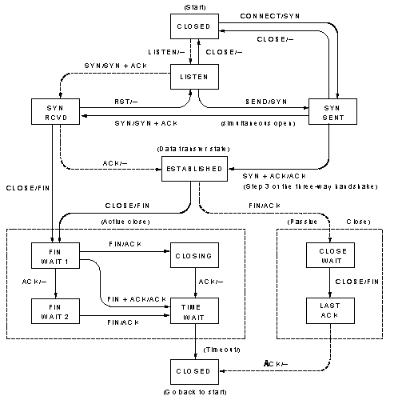
TCP, FSM
Notes:
This diagram, taken from Tanenbaum figure 6.28, shows the finite state machine describing the connection management for TCP. The solid lines are the normal routes for a client and the dotted lines are the normal routes for a server.
Small example:
Consider a client trying to establish a connection. It starts in the CLOSED state. A Connect primitive is executed resulting in a SYN request being sent and TCP enters the SYN SENT state. If a CLOSE primitive is issued at this stage then TCP can immediately return to the CLOSED state, there is no need to issue a FIN as the three way handshake will ensure that the server does nothing. When the SYN+ACK arrives from the server it sends an ACK and enters the ESTABLISHED state.

Slide 174
Transmission Policy
flow controlled through window size
  window = 0
    no data transmission except urgent data or 1-byte segment to establish window size
Nagle’s algorithm
  used for slow applications like telnet
  send first byte immediately
  buffer subsequent bytes until
    ack received or half of window or maximum segment
Notes:
TCP controls flow between the two ends by announcing explicit window sizes rather than relying solely on acknowledgements.
If the window size is zero then the source must stop transmitting apart from two exceptions. First, urgent data can always be sent. This allows for the potential flushing of buffers. Second the source TCP is allowed to send a one byte data segment which will force the receiver to reannounce the next byte expected and the current window size. This allows the source to actively probe the receiver to avoid deadlock in the event of packet loss.
One problem that arises with slow applications like Telnet is that the characters to be sent arrive so slowly the network overhead is enormous. The solution to this problem is Nagle’s algorithm. When it is applied the first byte of a session is sent immediately. After that the characters are stored until the ACK for the previous packet arrives (or the buffer reaches half the window size or the maximum segment size is reached).

Slide 175
Silly Window Syndrome
receiver with full buffer
  application reads 1 byte
  TCP advertises a 1 byte window
  leads to massive overhead
prevent small window sizes
  wait for maximum segment size to be available
  or half of maximum window size
Notes:
What happens when a receiver has a full buffer but the application is reading from it very slowly. When one byte is taken from the buffer, the receiver advertises a one byte window. The source then sends a single byte and this process continues one byte at a time with a huge network overhead.
The solution is to ban TCP from advertising a small window. The window is only opened when half of the buffer space is available or the maximum allowed segment size is available.

Slide 176
Congestion Control
Need to detect it
  assume (relatively) noise free line
  all lost packets are congestion induced discards
  timeouts become an indicator of congestion
Manage a congestion window
  separate from the window advertised by the receiver
  maximum bytes to send is smaller of the two
  size controlled by congestion algorithm
Notes:
TCP also manages congestion. It does this by maintaining a second window dedicated to congestion. It maintains two windows as they respond to quite different problems. The receiver window manages the ability of the receiver to handle the received data. The congestion window is there to manage congestion occurring in the network before the data ever gets to the receiver. Congestion will result from too many other senders trying to use the network at the same time.
The TCP control is based on an assumption that networks are relatively good and few packets are lost because of noise. In this case, a lost packet can only have resulted from a discard in the network. So when a timeout on the acknowledgement occurs TCP assumes a packet has been discarded and that congestion is occurring.
The sender will take the smaller of the receiver managed window and the congestion window as the maximum number of bytes to send.

Slide 177
Congestion Algorithm
Setting window size
  Initialise congestion window to maximum segment size
  send one segment
  keep doubling number of segments until a timeout occurs or receiver window is reached or threshold is reached
  if above threshold increase window size linearly
Threshold
  Initialise to 64k
  set to half current congestion window when timeout occurs
Notes:
The congestion algorithm consists of two main parts: setting the congestion window size and adjusting the threshold between exponential and linear growth of the window.
Initially the congestion window is set to the maximum segment size being used. One segment is then sent and if it is successfully acknowledged the window size is doubled and two segments are sent. This doubling process continues until either a threshold is reached or the receiver window size is reached. Once the threshold is reached the window size increases linearly after that. For some reason this algorithm is known as “slow start” despite being an exponential start!
The threshold is initially set to 64kbytes but is reduced to half the current window size when a timeout occurs. Also, a timeout causes the algorithm to re-start the slow start process described in the previous algorithm by setting the current window size to the maximum segment size.
If too many ACKs are lost in quick succession this leads to a collapse of the window as the threshold is decreased exponentially (by half) each time.

Slide 178
Timers
Data Link Layer
  highly predictable round trip time to to single link
Transport Layer
  highly unpredictable round trip time
  many links involved
  routes may vary from packet to packet
use smoothed estimates
  round trip time
  standard deviation
Notes:
In the data link layer there is little to be said about setting timeouts. The connection is a direct one between two machines and there is almost no statistical contribution to the total round trip time.
In the transport layer the situation is different as the packet will have traveled over many links and through many machines. Also the path might vary from one packet to another. In TCP the timeout is managed through the use of smoothed estimates of both the round trip time and its standard deviation.
When a packet is successfully acknowledged TCP has a measurement M of the current round trip time and it can compare this to the current smoothed value to obtain an estimate of the standard deviation.

Slide 179
User Datagram Protocol
Source Port
Destination Port
UDP segment Length
Checksum
Checksum
  set to zero if not used
  if checksum is zero, send as all 1’s
Notes:
The UDP protocol has a simple header as shown in the slide.
The checksum is computed in the same way as for TCP including the psuedoheader.
The UDP segment length includes the 8 byte header and the data.
UDP is principally used by the Name Server protocol and the Trivial File Transfer Protocol.

Slide 180
Next Lecture
Problem diagnosis
Performance enhancement
Baseline measurements
  introduction of new service
Notes:
In the next lecture we will look at the problems involved in making network measurements.
There are several reasons for doing this.
The simplest is fault finding. If the network seems to be responding very slowly it would be useful to have some idea of where the problem is located.
Another obvious application is performance enhancement. There are many parameters which affect the overall performance of a network. In order to tune these it is necessary to have a good measurement of network performance.
Finally, when introducing new services it can be useful to make measurements before (baseline) and after the service to determine the impact on network performance.

Slide 181
Network Performance
Problem diagnosis
Performance enhancement
Baseline measurements
  introduction of new service
Notes:
In this lecture we will look at network performance.
There are several reasons for doing this both as a design issue and a measurement issue.
The simplest is fault finding. If the network seems to be responding very slowly it would be useful to have some idea of where the problem is located.
Another obvious application is performance enhancement. There are many parameters which affect the overall performance of a network. In order to tune these it is necessary to have a good measurement of network performance.
When introducing new services it can be useful to make measurements before (baseline) and after the service to determine the impact on network performance.
One of the key properties affecting network performance is design. The design not only involves the obvious physical properties such as bandwidth, topology and processing speed but also the implementation of the protocols in software can have a major impact.

Slide 182
Measurement cycle
Decide what you want to measure
Change one parameter
Does it make sense?
Measure it
Notes:
Here we review the basic cycle of measurement. The starting point is to decide what you want to measure. Whatever it is, it needs to be a good indicator of the performance that you are trying to measure or optimise.
Having decided what the quantity is to measure we then need to work out how that is to be done and to make the measurement.
Now we have a measurement it is a good idea to check to see if the measurements make any sense. A number of things can go wrong:
The measurements may be dominated by noise.
The measurement may not measure what you think it does.
The measurement is correct but your original understanding is wrong.
Having reached a point where you are satisfied that the measurement is useful you can now change some system parameter and see what effect it has. At this point you may run into another problem which is that the conditions in the network may have changed between the two measurements.

Slide 183
Sampling
Sample size
  need to build up statistics
  beware of slow changes in network condition
  beware of rare events
diurnal changes
  network use changes throughout the day
  night is not necessarily a ‘quiet’ time
  what is a typical result
Resolution
  fast events need a fine grained clock
Notes:
As with any measurement we need to take care of our measurement statistics. Remember that if E is the (random) error on a single measurement then the error on N measurements is E/sqrt(N). There can also be systematic errors such as the overhead involved in a call to a system time function. In order to achieve good statistics we need to use large N. However, we must be careful not to use such a large N that the quantity we are trying to measure is changing over the course of the measurements. We also need to be aware of rare events such as a router crashing and rebooting during a measurement.
Networks have diurnal (daily) changes resulting from the normal work patterns of users and processes. Do not be tempted tot assume night is a quiet time as backups and database downloads are often performed during the night. We might want to measure some aspect of network performance under ‘typical’ conditions but even that is difficult to define. Even in an office there are some atypical events such as re-installing some software over the network.
Measurement resolution is always a problem. If we are measuring a fast event we need to ensure that the system clock has sufficient resolution to make the measurement meaningful.

Slide 184
Caching
used to enhance network performance
  store recently accessed data locally
  can lead to changes in what you are measuring
Buffering
  Remember TCP and UDP may not send data as soon as it is handed over from an application
  Congestion can cause changes in time spent in buffers from one measurement to the next
Notes:
Caching is a useful technique which can enhance network performance. Recently accessed data can be stored locally so that future accesses are speeded up. However, this can also cause problems with making measurements if a file is once accessed remotely and then from a local cache.
Buffering can also cause problems. Remember that both TCP and UDP are allowed to buffer data internally before ever sending it out onto the network. Also, buffers in the network routers can lead to random times spent in them as congestion comes and goes.

Slide 185
Extrapolation
generally non-scientific
  practitioners should be burnt at the stake
quiescent measurements don’t extrapolate
  congestion e.g. ALOHA throughput
  queueing theory delays
Notes:
Extrapolation is just about the most dangerous and unscientific game to play. In the absence of an underlying theory, results taken over some range of the dependent variable tell you nothing about the results outside the range. Even if we have a theory, it must have been tested under the conditions that apply in order to allow us to fit parameters and use the analytic formula for the extrapolation.
Note, fitting some results to a polynomial or other randomly chosen fitting function does NOT constitute a theory; not now, not ever, NEVER.
Always beware of making extrapolations based on quiescent systems. Remember the performance of pure and slotted ALOHA is the same under small loads. However, their peak throughput is significantly different. Even if you were operating an ALOHA protocol, remember that the simple theory for the throughput makes assumptions about the statistics of the packet arrival times. If, for some reason, the packets on your network don’t have those statistics the performance would be different.
Queueing also has a load dependent effect on systems. Factors of 1/(1-L) occur where L is the load.

Slide 186
Design
Rules of thumb collected by Mogul
Rule 1
  CPU speed is more important than network speed
    caused by software overhead of protocol stack
    minimum response time on ethernet is 102 μs
    in practice 1500 μs is hard to achieve
    cannot be true for ever
Notes:
Many of the design rules have come from folklore over time through the experience of network designers. These rules were collected together by Mogul in:
IP Network Performance, in Internet Systems Handbook, Lynch, D.C and Rose, M.T (eds), Reading, MA, AddisonWesley, 575-675, 1993
Rule 1 says that given the choice between upgrading the network bandwidth and the CPU speed you should always go for the CPU speed. This is due to the fact that the total transmission time has two components. The time to propagate along the physical medium and the time spent being processed in memory either in the network or at either end. In practice the propagation time is usually much the smaller of the two and therefore it is possible to get better throughput with a faster machine. Remember that the processing time is the sum of all the individual processes and that one slow machine in a link will dominate. So improving your machine will not make everything better.
As an example, the minimum response time on an ethernet from another machine is 102 μs which is the time taken to transmit two minimum length (64byte) packets. In practice it is hard to get the time down to 1500 μs which is about 15 times longer. The transmission time in this case is only 6.8% of the total.

Slide 187
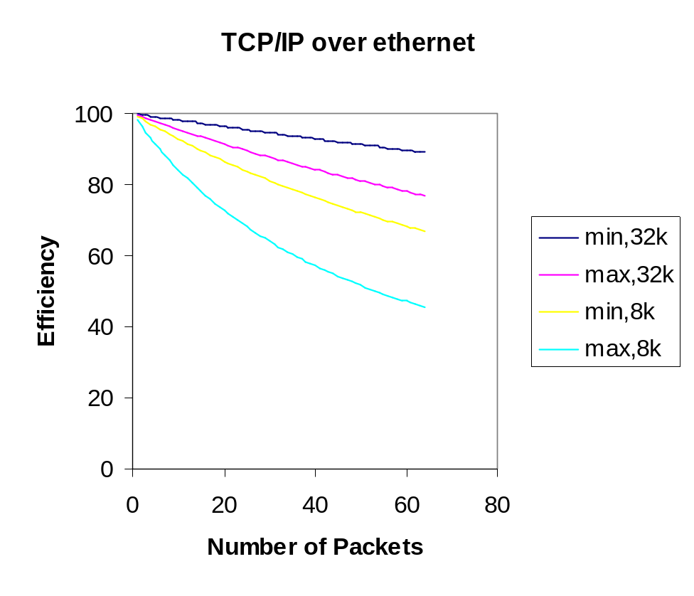
Rule 2
Reduce packet count in a session
  Every packet has an overhead of header information
  Send D bits of information in N packets
  Packet has a header of length H
  Total number of bits sent is D+NH
  Efficiency is D/(D+NH) = 1/(1+NH/D)
Notes:
Rule 2 says that data should be sent in as large a packet as possible. This is simply in order to reduce the overhead of packetisation.
Consider sending data using TCP/IP over an ethernet. The overhead per packet can be anything from 62 bytes to 150 bytes. In the graph the efficiency is shown for the minimum and maximum combined header lengths for the transfer of a 32kbyte file and an 8 kbyte file.

Slide 188
Rule 3
Minimise context switches
  to do with the way operating systems work
  each application, including the OS, runs in its own memory space
  this could be particularly disastrous if disk virtual memory is involved
  cache flushing reduces performance
  can be a major problem even on high performance machines
Notes:
Rule 3 really concerns the design of software which implements the network protocols. It stems from the way most operating systems handle multiple applications. In order to have several programs running at once the operating systems make use of program spaces, each one allocated to a particular application. When a switch between them occurs there is inevitably some overhead, for example saving register configurations. Most modern computers make great use of caching to improve speed of memory access and this fails immediately after an application switch as the cache no longer contains relevant memory locations.

Slide 189
Rule 4
Minimize copying
  Requires memory access which is generally much slower than instruction execution
  Multiple copying can occur when data is passed between different processes
  Even a Cray computer can be slowed down so much that it can’t keep a fast ethernet full
Notes:
Copying data within memory can seriously slow down a machine. Memory access times are generally much longer than the time to execute an instruction. If a packet were copied between different processes running in each layer then four or five separate copies may occur.
Even a machine like a Cray can be reduced to the level of a pocket calculator if too many copies are performed. This observation has lead to the development of ‘light’ protocols which are suitable for achieving high throughput but without much functionality.

Slide 190
Rule 5
Delay is dominated by processing
  Even when it isn’t there is nothing you can do about it as the speed of light is a universal constant
Bandwidth
  increases peak speed
  does not affect the delay of a single bit
  can reduce message delay, for N bit message, bandwidth B
  message time is 2L/v+N/B
Notes:
This rule is more of a warning. Increasing the physical layer bandwidth does nothing for the physical delay. In most systems the total delay is dominated by the processing time in the various routers and end machines.
Increasing the bandwidth of a link can increase the peak throughput available. Tannenbaum comments that doubling the bandwidth does nothing for the delay. At the single bit level, he is right but consider the desire to transmit an N bit message over a link with bandwidth B, length L and propagation speed v. The time taken for the end of the message to arrive is of order 2L/v+N/B. So a very long message might be dominated by the transmission time rather than the propagation time and in that case increasing the bandwidth could lead to a reduction in the message transmission time.

Slide 191
Rule 6
Congestion
  avoid it if at all possible
  when it occurs, there is a temporary increase in traffic as the network tries to reduce the load
  packets are discarded causing re-tranmission
Notes:
Congestion is pure bad news and is best avoided if at all possible. Remember that under congested conditions network throughput typically decreases with an increase in load. As the network has to take some positive action to try and reduce the congestion this means that there will be a temporary worsening of the situation as more control packets are generated.
Congestion causes packet loss which wastes bandwidth at precisely the time the network needs it most.

Slide 192
Rule 7
Timeouts
  avoid if possible since they cause repeated transmissions
  choose timeout values that are conservative
    waiting a little longer is friendly
    constantly re-transmitting unnecessary packets is not
Notes:
Timeouts are another potential cause of wasted bandwidth. They are necessary to cope with errors on the network but they do lead to repeated transmissions which are wasteful if not necessary. The choice of timeout value is very important and, as we have seen, is layer dependent. By setting the timeouts a little conservatively we may wait a little longer but this is better than wasting bandwidth by constantly re-transmitting packets which would have been successfully received.

Slide 193
Summary
Most of the problems are software related
Need to use efficient design
  e.g. Order CASE statements by likelihood
  only re-compute packet fields which can change during a session
Notes:
Most of the design rules are related to issues of protocol implementation in software. It is therefor important to use an efficient design for the software.
Examples of good design are:
CASE statements should be ordered by likelihood of occurrence. When they are compiled they are usually tested in the same sequence as written. Thus if the most likely condition to occur is at the end of the list it will only be reached after all the other conditions have failed.
Don’t compute everything afresh every time. Most of the fields in protocol headers remain the same during a session and these can be precomputed when the session is initiated.
Actually, these are just good design rules which apply to any form of software.

Slide 194
Next Lecture
Network Security
  encryption
    ciphers
    one time pad
    DES
    Public Key
  authentication
  signatures
Notes:
In the next lecture we look at the issues related to Network Security.

Slide 195
Security
Network Security
  encryption
    ciphers
    one time pad
    DES
    Public Key
  authentication
  signatures
Notes:
In this lecture we look at the issues related to Network Security.
First we will study the various techniques that are used to encrypt data.
Next we look at some related issues such as authentication which involves trying to establish that who you are talking to is who they say they are and signatures which enable you to tell that a document is from the person it claims to be.

Slide 196
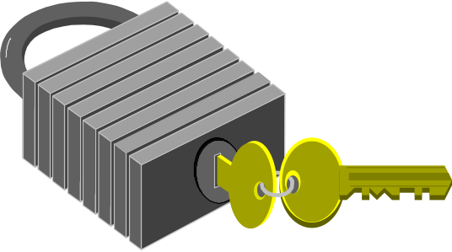
Encryption
Data protection
  transform data into a form readable only by the intended recipient(s)
  network feature
Keys
  Used as part of the encryption process
  management
  distribution
Notes:
The fundamental process by which security is achieved is encryption. Using some process the data is translated into an unreadable form. Unreadable, that is, to anyone except the person or persons you actually want to read it. This can be done simply for the reasons of secrecy on a person to person basis. It can also be a feature offered in a network where all data is automatically encrypted on entering the network and then decrypted on leaving the network thus offering secure transmission to the customers.
Typically encryption is thought of as placing the data in a box which needs a key to lock it up and also to undo it.

Slide 197
Cryptography
Plaintext
Ciphertext
Encryption
Encrypt function
Alice
Encryption key
Eve
Bob
Ciphertext
Plaintext
Decryption
Decrypt function
Decryption key
Notes:
In cryptographic terminology the message to be sent is known as the plaintext and the encrypted version is known as the ciphertext.
The boxes here show the general principle. The encryption process consists of taking the plaintext and applying some encryption function to it using a key.
The decryption process achieves the inverse of this by applying a decryption function to the ciphertext, using a decryption key, to obtain the original plaintext.
Note that, in general, it is not necessary for the encryption process to be the same as, or even the inverse of, the decryption process. Also the encryption and decryption keys need not be the same.

Slide 198
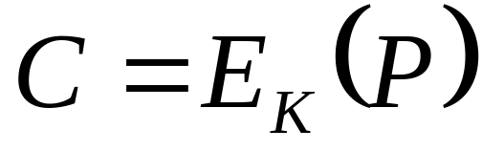
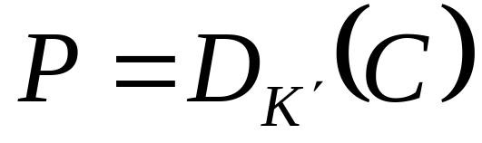
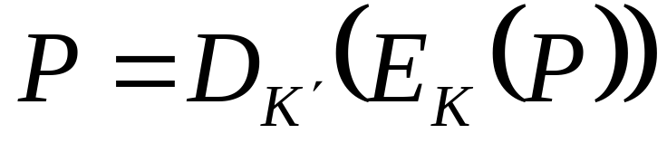
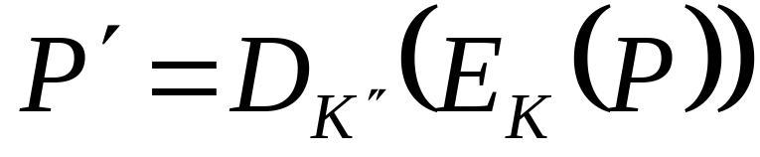
Representation
Encryption
Decryption
We need
and
To be very different from P
Notes:
This slide shows the traditional mathematical representation of the cryptography process. The encryption process is considered to be a function with the key K as a parameter. The decryption process is a second function with the key K’ as a parameter.
The third equation on the slide simply expresses the fact that encryption followed by decryption leaves the plaintext unchanged.
The final equation is one of a set of desirable properties which make code breaking difficult. If we decrypt a ciphertext with an incorrect key then we want the resulting plaintext to be ‘far from’ the correct plaintext. By ‘far from’ we mean that if a particular bit in the original plaintext is a one then the probability of that bit being one is 1/2 if K” is not the same as K’ and one if it is the same.

Slide 199
Types of Cipher
Secret Algorithms
  Only the intended recipient knows how to decrypt the cipher
  means that Alice and Bob must have met securely
Secret Key and Public Algorithm
  confidence if algorithm not broken
  still means that Alice and Bob must have met securely
Secret and Public Keys and Public Algorithm
  enables people who have never met to communicate securely
  problem of authentication
Notes:
Ciphers are broken up into a number of different types.
A secret algorithm cipher is one where the details of the encryption and decryption process are known only to Alice and Bob. In order for this to have happened they must have exchanged that information in a secure way and since we don’t have a secure network (yet) then they must have met in a secure environment.
A publicly known algorithm with a secret key known only to Alice and Bob is very similar. However, the main advantage is that the security of the algorithm can be tested and if it is not broken then they can have some confidence that the technique is a good one.
The final category is generally known as public key cryptography. This technique enables people who have not met to communicate securely. The issue of security is then replaced with one of authentication. How do you know that the person sending the message is who they say they are? Of course, if you had a shared secret you could check but then you would have had to meet.
For most network applications we assume E is known and that we are trying to see if anyone can work out D (or their keys if both E and D are known).

Slide 200
Code Breaking
Exhaustive search
  Try every Key until you get a sensible message
  Problem space grows exponentially with length of key
Back Door
  Alternative decryption process exists which depends on a small key
Known Plaintext attack
Chosen Plaintext attack
Statistical methods, Birthday attack
Notes:
Code breaking is a huge branch of mathematics and there are many techniques such as:
Exhaustive search: typically used in public key schemes where every key is tried in succession until the correct one is found. The first Internet code breaking of a 40bit key cipher was done this way. The problem grows exponentially with the length of the key so breaking an 80 bit key is way more than twice as hard as a 40 bit key.
Back door: This refers to an algorithm that can be reversed without using the correct decryption key in a way that requires a small, possibly one, attempts. Cryptographers often worry that government approved ciphers for the public have back doors built into them so that the security services can access any data they want to.
Known plaintext attacks: if you know the original plaintext of a particular message and the ciphertext it was translated to then it might be possible to work out something about the encryption process. This is one of the techniques that was used in breaking the Enigma cipher.
Chosen plaintext attack: this is the hardest to protect against. The cryptanalyst is allowed to choose P and be told C.
Statistical methods: If the encryption algorithm leaves some correlation between the plaintext and the ciphertext then it might be possible to look for those occurrences and deduce some properties of the cipher or the message.
Birthday attacks: a special class of attack based on the fact that the probability of two people out of twenty having the same birthday is about a half.

Slide 201
Substitution Ciphers
Define a permutation of the alphabet e.g.
  abcdefghijklmnopqrstuvwxyz
  mnbvcxzasdfghjklpoiuytrewq
Substitute corresponding letter in permutation to encrypt or decrypt
Problems
  each letter always appears as the same cipher-letter
  language has structure
  even quite small messages can be broken if contextual information is available
Notes:
One of the simplest codes is the substitution cipher which defines a permutation of the alphabet and then replaces each plaintext letter by its corresponding letter in the permutation. Thus, internet would become sjucojcu.
The problem with this form of code is not the size of the key space which is 26! but that the algorithm is weak. The weakness stems from the fact that language has structure. Letters appear at different frequencies in English, e is the commonest and then t, then o,a,n,i. If we have a large amount of ciphertext we can analyse the frequencies of occurrence of the letters and work out the permutation that was used.
Even a small amount of text may be broken if some contextual information is available. This might be simply knowing where the words start and end. It might involve knowing something about what the message might contain.
For example, the following coded message is sent to a stockbroker:
mtdd jdd zivzhj majxtm
Try and guess what the message might have said.

Slide 202
One Time Pad
Alice and Bob need a shared sequence of random binary bits
The message is expressed in binary form
Form an exclusive or of the message and the random sequence
Discard the sequence
This is the only known provably secure code
If you re-use the sequence the cipher is compromised (subject to statistic attack)
Need a key as long as the data
Notes:
The one time pad is a simple code. Alice and Bob need to share a random sequence of binary bits. When the message has been expressed in binary form the ciphertext is formed from an exclusive or between the message and the random sequence. The sequence must then be discarded and never re-used for another message.
This is the only known provably secure encryption algorithm. To see this consider sending a single bit message perhaps corresponding to 1=yes, 0=no. The ciphertext seen by eve is 1, the random sequence (of 1 bit) was either 1 or 0 with equal probability so both possible messages are equally likely. The security of the code now rests on the secrecy of the random bit sequence. To see that re-using the random bit compromises the code consider sending a second message of the same form. The second ciphertext is the same (different) as the first one. Since the random bit was the same we can deduce that the message was the same (different) as the first one. In many cases this would be enough.
The major problem with using this code is that the random bit sequence is as long as the data. To put it another way, the key is the same length as the data. So, to send large amounts of data we would need large amounts of shared random bits.
The real work of cryptographers is devising codes which are secure but have a key which is small.

Slide 203
Transposition and Substitution
Decoder
Encoder
P-Box
S-Box
Notes:
Modern cryptographic algorithms still rely on the basic operations of permutation and substitution. These two operations are illustrated on the slide.
The P-Box (permutation) is a one to one reconnection of the inputs to the outputs. This can be performed in hardware very quickly.
The S-Box (substitution) consists of a decoder stage which interprets the input lines as a binary number and makes the appropriate output line go high, followed by a P-Box and then a decoder which produces the binary representation of the number of the line on the output side of the P-Box which is high.
Complex ciphers can be formed by taking combinations of these two basic elements. Each of the basic elements is configured in some way by the key that specifies the cipher.

Slide 204
DES
Data Encryption Standard
  developed by IBM
  64 bit block cipher
  Iteration involves swapping and XOR
  key length 56 bits
  still a monoalphabetic substitution cipher
  electronic codebook mode
Initial Transposition
Iteration 1
{
Key
Iteration 16
32 bit swap
Inverse Transposition
Notes:
The diagram shows the architecture of the Data Encryption Standard algorithm developed by IBM and adopted for use by the US government. It codes 64 bit blocks of data by passing them through the sequence of operations shown. The initial transposition and the final transposition are inverse of each other. The heart of the cipher lies in the function applied in each of the 16 iterations. Each iteration contains some bit swapping and also passing though a sequence of S and P boxes controlled by the Key which is 56 bits long.
DES is still a monoalphabetic substitution cipher. For a given key there is a unique output for each input and if it is used like this (electronic codebook mode) the cipher can be subverted even without breaking it. This can be done by reordering the 64 bit blocks to create an equally valid message. Of course, the original message would have to have been set up in such a way that this makes sense.
Even if the subversion attack was not possible the cipher would be weaker against a known plaintext attack as eight character sequences could be built up.

Slide 205
Cipher Chaining
Avoid codebook problems
  provide feedback in the encryption process
  output depends on a longer history of 64 bit blocks
  need an initialisation vector (IV) to start the process off
P_{n}
E_{K}
C_{n}
#
1 block delay
Notes:
Chaining is a general way to get around the problems of ciphers working in electronic codebook mode. In order to break the association between a given plaintext block and its cipher block, the cipher is embedded in a feedback loop which also contains an additional exclusive or gate (marked # in the slide). The nth plaintext block is first exclusive ORed against the previous ciphertext block and the result is then encoded to produce the nth ciphertext block. All that is needed now to complete the specification is an initialisation vector (IV) to feed in to the exclusive or gate as the first plaintext block arrives. The complete cipher is then specified by the Key and the IV.
The decryption sequence can easily be constructed by writing the functional definition of the feedback loop:
From which we can solve for the plaintext as:
where D_{K’} is the decryption process for E_{K}.
This is fine for encrypting files where all the data is known in advance but is not much good for encrypting slow or streamed traffic.

Slide 206
Byte feedback mode
C_{n-8}
C_{n-7}
C_{n-6}
C_{n-5}
C_{n-4}
C_{n-3}
C_{n-2}
C_{n-1}
Shift register
E_{K}
One byte delay
Select leftmost byte
P_{n}
C_{n}
#
Notes:
When the data arrives slowly, as from a telnet terminal, we need a scheme which can allow single bytes to be encrypted while retaining the security of a larger cipher.
This is achieved using a byte feedback mode. The fundamental plaintext and ciphertext blocks P_{n} are now in units of single bytes. The current plaintext byte is exclusive ORed against the part of the 64 bit encryption of the previous eight ciphertext blocks.

Slide 207

Public Key Cryptography
Introduced in 1976 by Diffe and Hellman
Encryption process E_{K}
Decryption process D_{K’}
E, D and K are public
K’ is private
Public data
Alice = K_{A}
Bob = K_{B}
Alice data
K_{A}
Alice
K’_{A}
Bob
K’_{B}
E_{KA}(P)
Notes:
Public key cryptosystems were first described in 1976 by Diffe and Hellman. They rely on having publicly known algorithms together with a public and a private key.
Suppose Bob wants to send a plaintext P to Alice. First he requests Alice’s public key from a server. Next he encrypts P using the known algorithm E and Alice’s key and sends the resulting cipher text to her. Since the ciphertext was obtained using Alice’s key she and only she can decrypt it to obtain the original plaintext.
This technique relies entirely on the difficulty of deducing K’ given the knowledge of K. There are no known algorithms for which this difficulty has been proven so the security of public key systems is largely a matter of faith.

Slide 208
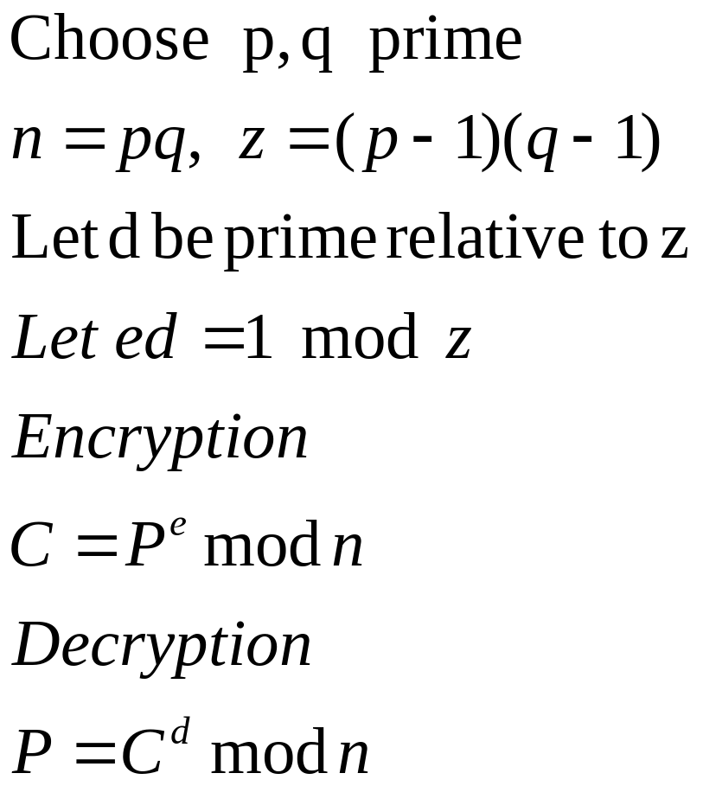
RSA
named after the inventors Rivest, Shamir and Adelman, 1978
Notes:
RSA is an algorithm believed to be suitable for public key cryptography.
First we choose two large primes p and q and define two numbers n and z as shown in the slide. We then choose a number d which is prime relative to z (i.e. It is not a factor of z) and find the number e as defined in the slide.
The pair (e,n) is the public key and the pair (d,n) is the private key. The encryption and decryption functions are shown in the slide.
The difficulty in breaking the cipher comes from the difficulty in factoring large numbers such as n. There is no known ‘fast’ (polynomial time) algorithm for finding p and q given n. If there was we could quickly deduce d given e and z.

Slide 209
RSA example
p=19, q=13 => z=18*12=216 and n=19*13=247
choose d=7
want 7e=1 mod 216 gives e=31 (Euclid algorithm, see http://users.erols.com/eweidaw/applets/EuclidExtension.html)
Let P=3, P^{e} mod 247 = 185
P = 185⁷ mod 247 = 3
In practice need to use special algorithms to handle very large integers
Notes:
In this slide we show a particular example of the RSA algorithm. Even using small numbers for p and q we rapidly generate some very large numbers to handle like 3^31 is needed to encrypt the plaintext represented by the number 3.
This details of this example are contained in the spreadsheet lecture14.xls which is available on the website. Note that to calculate the number e we need to use Euclid’s extended algorithm ( a Java applet can be found on the website quoted on the slide).
In practice these sorts of cipher have to use specially designed algorithms that can handle very large (hundreds of digits) integers.

Slide 210



Authentication
Suppose I have established a secure link
How do I know the person at the other end is who they say they are?
Man in the middle attack
Need some shared secret information or a trusted third party
Bob
Alice
Notes:
Even if we accept that we can establish communication over a link which is ‘sufficiently’ secure we are still left with a big problem. How do I know that the communicator at the other end of the line is who they/it claim to be? How do I know that they are not just pretending to be the intended recipient.
The classic example of such a problem is known as the ‘man in the middle attack’. Here a third party cuts the link in half and sits in the middle. By pretending to be Alice to Bob and to be Bob to Alice they can discover the entire conversation.
The only real way out of this dilemma is for Alice and Bob to have some shared secret information. In the setup phase they can then exchange messages which are encrypted using the onetime pad using the secret information as the key. Since the onetime pad is unbreakable the eavesdropper cannot do anything with this part of the conversation. While this is a good solution it is not always practical since Alice and Bob must have met at some point in order to exchange the secret information.
In order to enable people who have never met to authenticate each other there is a technique that is proposed which is the use of trusted third parties. These would have previously established the authenticity of users and institutions registered with them. When two such parties wish to communicate they both speak independently to the third party who establishes their authenticity.

Slide 211
Authentication protocols
In practice , protocols tend to use the secret information as a master key to enable them to set up a session key that is only used for a particular conversation.
1
A
2
RB
3
Bob
Alice
K(RB)
4
RA
5
K(RA)
Notes:
In this slide we show an authentication protocol involving five stages.
In the first stage Alice announces herself to Bob.
In the second stage Bob send an unencrypted random number to Alice.
Next, Alice returns the random number encrypted with their secret key. At this point Bob is satisfied that Alice is who she claims to be.
The fourth stage involves Alice sending a random number to Bob.
Finally Bob returns the random number encrypted with the secret key.
Both users can now be confident that the other party is authentic.

Slide 212
Signatures
Legal and security issues
  to establish authenticity of documents
  to establish the author
Need a method of digital signing
  document not necessarily encrypted
  signature must be difficult to forge
    hence base on encryption techniques
Notes:
It is not difficult to imagine legal and security reasons why we would want to be able to establish the authenticity of a document and its author. Both are needed as we want to establish that X wrote this document and exactly this document (i.e. it has not been altered).
In order to do this we need some method of digitally signing a document even if we have no need to encrypt the document itself. Clearly, the signature has to hard to forge so it is not surprising that the techniques are based on the use of cryptography.

Slide 213
Public Key Signatures
If E(D(P))=P as well as the usual D(E(P))=P
  use a decrypted copy of the plaintext as the signature
  message = P, signature = D(P)
  remember each user has a secret key for D
  only need to send D(P) since E is public
  D(P) can be encrypted with Bob’s key in the normal way for secure transmission and to prevent plagiarism
Notes:
Under normal use a cipher only has to have the property that D(E(P))=P. If it also has the property that E(D(P))=P then it can be used as a digital signature. The signed document simply corresponds to the decryption process having been applied to the document so D(P) would be the signed version of document P. This is so since the decryption key is secret and unique to each user so only the sender can produce D(P). If the signed message is sent unencrypted then everyone can read it and can verify who sent it by using the public key for the encryption process (which is being used to decrypt the signed file). At this stage it is still possible for plagiarism to occur. If the message was an original piece of work being submitted to publishers then it could be read and re-signed by anyone using their secret key. In order to prevent this the signed message is sent to the intended recipient encrypted with their public key.
This whole process mixes up the two requirements for authentication and secrecy. Let us now consider a scheme whereby unencrypted documents can be authenticated.

Slide 214
Message Digests
A message digest is a fixed length piece of text which depends on the original message
the digest is then signed as discussed in the last slide
MD5 is an internet standard, RFC 1321
  breaks up the input message into 512bit blocks
  pads last block and adds message length information
  mixes each 512 block with a 128 bit buffer
  produces a 128 bit digest
Many messages correspond to each digest but digest space is large so probability is small
Notes:
In order to produce something more akin to a real signature, i.e. a small piece of text at the end of a message, message digests were introduced. The digest is a fixed length piece of text which depends in a complicated way on the original message. The size of the digest also needs to be sufficiently large that the probability of two messages having the same digest is small. In order to produce the digital signature the digest is encrypted using the author’s private key and the decryption function as explained in the last slide.
One such message digest, used on the internet, is MD5 and is specified in RFC1321. The message is broken up into blocks of 512 bits and the last block is padded and has message length information added to it. Each of these 512 bit blocks is then mixed with a 128 bit buffer in a complicated way. At the end of this process the contents of the buffer define the message digest.

Slide 215
Next Lecture
Domain Name System
Simple Network Management Protocol
Notes:
In the next lecture we will discuss the domain name system which translates named addresses such as www.aston.ac.uk into IP addresses.
We will also look at the simple network management protocol SNMP.

Slide 216
Managing the Internet
Domain Name System
Simple Network Management Protocol
Notes:
In this lecture we will discuss the domain name system which provides a number of services to users such as translating named addresses such as www.aston.ac.uk into IP addresses.
We will also look at the simple network management protocol SNMP.

Slide 217
Domain Name System
Based on Hierachical Name System
  distributed database
Provides translation services to users
  translates names into IP addresses
  allows the creation of aliases
  allows the specification of email servers
  specifies the owner of address information
Notes:
The domain name system (DNS) is one of the central facilities provided to users that allows the Internet to be used. It is structured as a hierarchical name system and implemented as a distributed database. The distribution of the information allows much better access times tot he information and also allows much more local management of the information.
DNS provides a number of services to the users of the Internet. The most important is that it translates easy to remember names (such as amazon.com) into IP addresses (in this case 208.216.182.15). It also allows the creation of aliases so that many different names can be mapped to the same IP address. It allows for the association of an email server to a domain or sub-domain. It also includes information about who is the owner of information about a particular sub-domain.
The DNS system is specified in RFC1034 (which discusses a lot of the concepts)and RFC1035 (which obsoletes RFC1034 but is itself updated by many other RFCs).

Slide 218
Hierarchical Names
com
org
mil
jp
uk
za
Country names specified in ISO3166,
note uk is not there it should be gb
ac
co
aston
Notes:
The naming system used is hierarchical and all names stem from an unnamed root. Each entry on the naming tree is a domain and is responsible for the naming of all its subsidiaries or sub-domains. The highest level falls into two categories, country and generic. Each country has its own unique specifier. The generic categories were almost exclusively USA based in the early days of the internet but are now becoming increasingly international especially the .com and .net domains. Fully qualified domain names are formed by listing (from the lowest level) the sub-domains that must be passed through in order to get to the particular sub-domain with each entry being separated by a ‘.’. So Aston university becomes aston.ac.uk.
The UK is broadly divided into two sub-domains ‘ac’ for academic institutions and ‘co’ for companies. Because the naming system only defines names and not physical infrastructure or addresses, it is possible for a given host to be listed under many domains. For example, a company may want to be listed under .com as well as .co.uk.
Each domain (or sub-domain) is autonomous and is responsible for the naming of entries below it on the tree. Thus the manager of ‘aston.ac.uk’ can use any name for hosts in that domain without needing to worry about whether that particular host name has been used before.

Slide 219
Resource Records
These are records held in a database which specify the properties of a particular domain
  The name tree is broken into non-overlapping zones
  Each zone has a master source and may have other copies
  The master source for each zone is known as ‘authoritative’
  The entire database is distributed around the Internet
  Cached copies can be held for a limited time
Notes:
The DNS system is stored in the computer as a set of resource records. The domain tree is broken up into a set of non-overlapping zones with the highest member of the tree in each zone being responsible for the maintenance of the DNS information within that zone. The zone has a master copy, referred to as authoritative, which is the definitive set of records but may have other copies within the zone to ease the traffic on a particular server. The complete DNS database is thus distributed around the Internet.
In order to prevent DNS information being sought outside a zone every time a request is made, the servers are permitted to cache previous requests that have been made. The cached copy has a restricted lifetime and when that has expired the cache is purged.

Slide 220
DNS Lookups
Requests based on UDP
  single packet request and single packet response
Recursive requests
  DNS servers pass on the request via top level servers to the authoritative source
  chain of requests and responses formed
Non-recursive requests
  each server responds with the answer OR the address of a server which is ‘closer’ to the authoritative source
Notes:
DNS lookup requests use UDP. The request and the response only constitute a single packet and so there is no need to set up a TCP connection and no need to acknowledge the packets. If a response or request is lost the client can simply re-issue a request.
There are two types of DNS service. The recursive service will always provide the correct address to the client. If the first server does not know the answer it goes to a higher level (initially) server to seek the information. Eventually the request will make its way to the authoritative source and the response will then propagate back along the chain until it returns to the client.
The non-recursive service does not pass on the request but returns the address of a server that is closer tot the authoritative source and it is up to the client to issue the next request.

Slide 221
Simple Network Management Protocol (SNMP)
Four components
  Managed Nodes
    could be a host, router, printer etc.
  Management Station
    generally a computer allowing a manager access to network information
  Management information
    specifies the state of nodes
  Management Protocol
Notes:
SNMP has four main components.
The concept of managed nodes. These are any device connected to the network capable of running an SNMP agent. The agent collects data about the device and the network. A node could be a host, router, bridge, printer or other output device.
A management station is a place where the network manager will access the status information and where configuration changes to the network devices can be made.
Management information specifies precisely what information each device should collect and how it should be presented.
The management protocol specifies how the controller and the agents work with each other.

Slide 222
Objects
SNMP-ese for variables
  Every defined object is a leaf on a tree whose top levels are the international standards bodies.
  Every object has a defined type (e.g. INTEGER)
  the way that the values of objects are communicated is specified so that different platforms can communicate
Notes:
The variables which agents must keep track of are known as objects in the SNMP world. Each object is defined as part of the object tree whose root level begins with the international standards bodies (ISO and ITU). Thus every object has a unique identifier consisting of the path from the root to the object.
Each object has a defined type such as integer, bit string and octet string.
The values of objects are sent at the bit level in a standard platform independent way. This is so that the details of internal representation are hidden from SNMP. The rules for doing this are known as the Basic Encoding Rules (BER)

Slide 223
Management Information Base (MIB)
Complete collection of objects
  the objects com in several groups
example groups
  IP, 42 objects, information about IP packet statistics
  TCP, 19 objects, TCP algorithms, parameters and statistics
  EGP, 20 objects, Exterior gateway protocol traffic statistics
Notes:
The complete collection of objects that the management station has access to is called the Management Information Base (MIB). For convenience these objects are sorted into several groups and a few examples are shown in the slide.
The IP collection contains counters which give information about the number of packets that have been discarded for various reasons. There are also variables which keep track of the statistics of datagram fragmentation and reassembly.

